Slide 1

Backward Design to Move Learning Forward
Michelle Withers
Associate Professor
West Virginia University

Slide 2
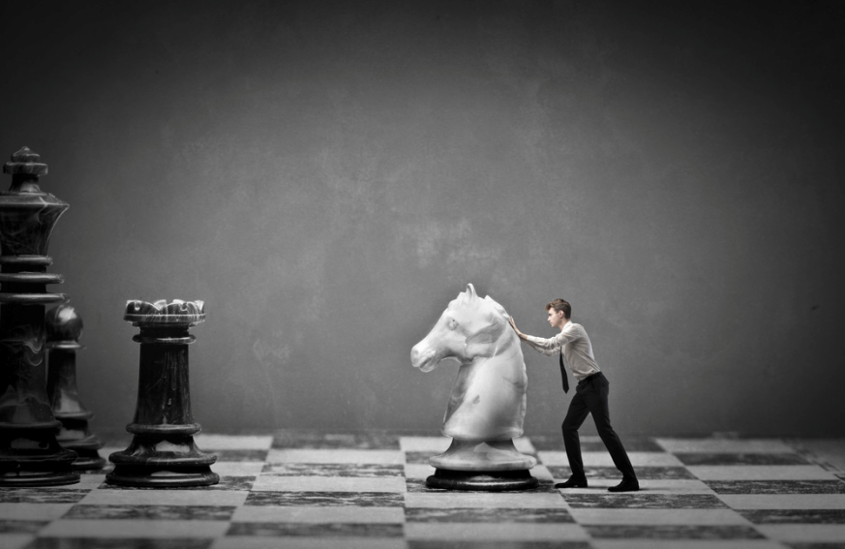
Notes:
Optional cover image?

Slide 3
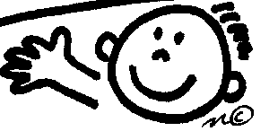
Acknowledgments
National Academies Summer Institutes
  Jo Handelsman, Bill Wood, Jay Labov
  NSF, HHMI, NAS
Workshop materials
  Randy Phillis, Jay Labov, Bill Wood

Slide 4

You will:
  Use Backward Design to:
    Turn learning goals into specific, assessable learning outcomes
    Align learning outcomes with learning activities and assessments at the same cognitive level

Slide 5
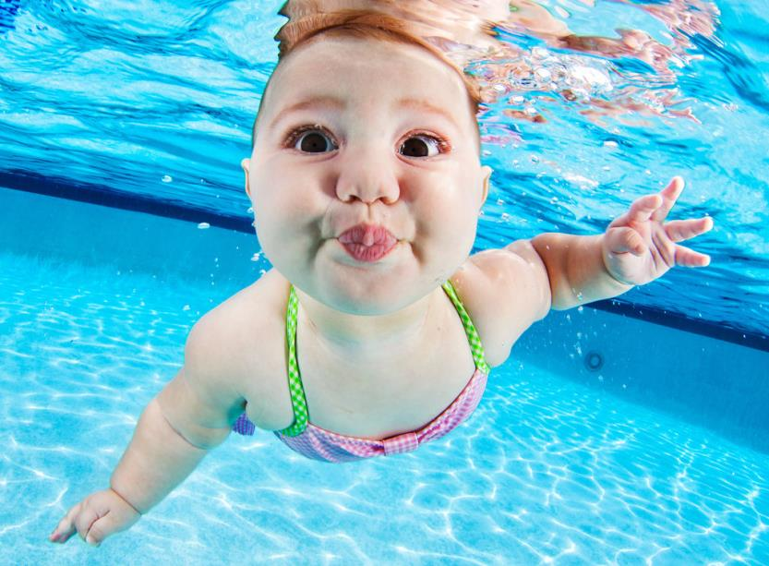
Notes:
Let’s dive in!

Slide 6
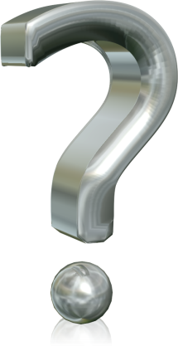
What are your students not getting that you want them to?
Notes:
Capture on large post-its

Slide 7
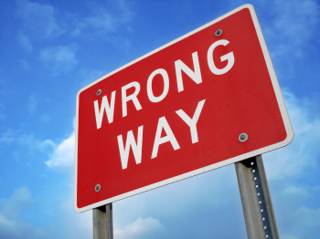
Twin Sins of Design
(Wiggins & McTighe, 1998)
What’s wrong with the following scenarios and how meaningful is the learning?

Slide 8

A new asst. professor of neurobiology teaches introductory biology for the first time. She has her students learn the distinguishing characteristics of all of the clades of protists covered in the text. The next year, she has to relearn this material to teach it again.

Slide 9

An introductory instructor designs a play to illustrate the movement of electrons through the electron transport system in chloroplasts during photosynthesis. The instructor prints out descriptions for the “actors” who follow those instructions during the activity.

Slide 10
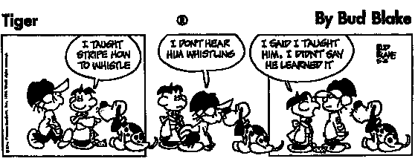
Backward design switches the focus from what we teach to what they learn
I don’t hear
him whistling
I said I taught
him, I didn’t say
he learned it
I taught Spot
to whistle

Slide 11
Backward Design
(Wiggins and McTighe, 1998)
What should
students know
or be able to do
by the end of
your course?
What evidence
will convince
you that they
got there?
How will you help
them get there?
Learning Outcomes
Assessments
Learning Activities
Notes:
11
goal-oriented instructional design that emphasizes learning not teaching

Slide 12
What is the difference between these two columns?
Learning Goals | Learning Outcomes
Understand gene expression | Students will be able to predict changes in amino acid sequences caused by mutations
Develop science process skills | Students will be able to interpret a graph
Understand evolution by natural selection | Students will be able to explain how adaptations seen in nature occurred
Notes:
Which is easier to assess?

Slide 13
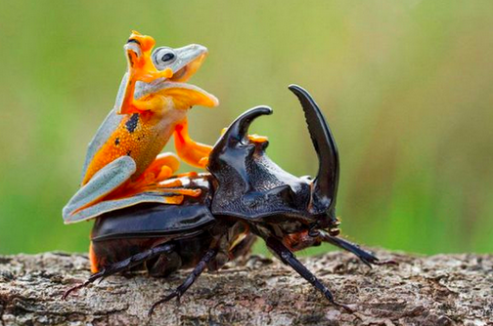
Notes:
Well done!

Slide 14
THE MONTILLATION AND USES OF TRAXOLINE
It is very important to learn about traxoline. Traxoline is a new form of zionter. It is montilled in Ceristanna. The Ceristannians found that they could gristerlate large amounts of fervon and then bracter it to quasel traxoline. This new, more efficient bracterillation process has the potential to make traxoline one of the most useful products within the molecular family of lukizes snezlaus.

Slide 15


It is very important to learn about traxoline. Traxoline is a new form of zionter. It is montilled in Ceristanna. The Ceristannians found that they could gristerlate large amounts of fervon and then bracter it to quasel traxoline. This new, more efficient bracterillation process has the potential to make traxoline one of the most useful products within the molecular family of lukizes snezlaus.
1. What is traxoline?
2. Where is it montilled?
3. How is traxoline quaseled?
4. Why is traxoline important?

Slide 16
“If they sit and listen, what they learn to do is sit and listen.”
- Randall Phillis, UMass Amherst

Slide 17
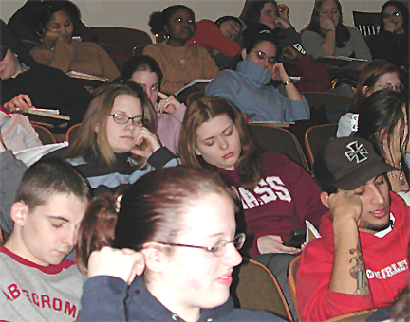

Slide 18
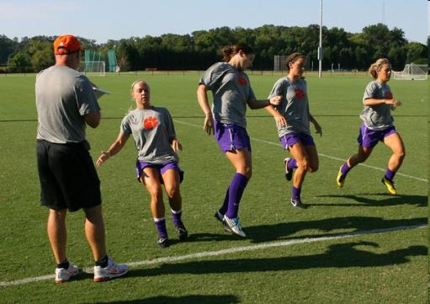
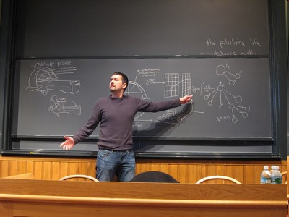
“Deliberate Practice”
The one doing is the one learning.

Slide 19
Backward Design Alignment Table
Learning Goal | Learning Outcome | Assessment | Learning Activity
What will students learn? | If they have learned it, what will students know and be able to do? | How will students demonstrate they know it or are able to do it? | What will students do to learn it?
Students will understand the transfer of information from DNA to proteins | Students will be able to predict changes in amino acid sequences caused by mutations | Students will predict the new amino acid sequence that results from a mutation in a given gene sequence | Students will be given a sequence of normal DNA and resulting amino acid sequence and must identify the reading frame, template/coding strands to predict amino acid changes due to mutations
Notes:
-choose any topic
-groups of 3
-10 minutes to come up with a quick backwards design, can be no more than 5 minutes to present idea/lesson
-does not have to be a complete lesson, just present idea
-What would you add with more time, was your opinion changed at all? Do you think this method is effective?
19

Slide 20
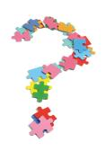
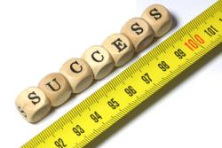
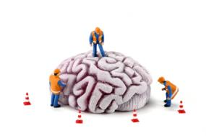
College Science Learning Cycle
ENGAGE
EVALUATE
CONSTRUCT

Slide 21
College Science Learning Cycle
ENGAGE
EVALUATE
CONSTRUCT

Slide 22
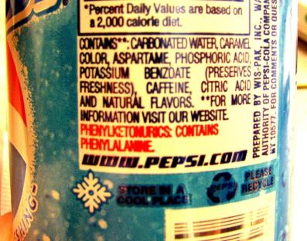
Poison Pop and PKU (phenylketonuria)
Genetic disorder - mutation in a liver enzyme that converts phenylalanine → tryosine
High [phenylalanine] becomes toxic to developing neurons
Each week that PKU remains undetected = 3 point drop in IQ
New-borns are tested at birth (Guthrie Test)
SI Gene Expression Group, 2004 (Norris Armstrong, Bill Barstow, Peggy Brickman, Phil Cunningham, Michael Hanna, David Njus, William Wischusen)

Slide 23
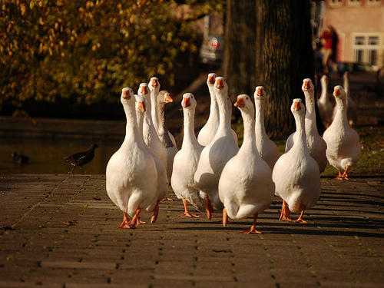
Group Activity: List three things that you know or need to know to answer the following question.

Slide 24
Genetic diseases, like PKU, confirmed that there is a link between DNA and proteins. Below is a DNA molecule and the amino acid sequence that would result when ribosomes translate the DNA sequence. Which nucleotides are responsible for this particular sequence of amino acids?
3’CGTTTTACCAAACCGAGTACTGAG5’
5’GCAAAATGGTTTGGCTCATGACTC3’
TRP-PHE-GLY-SER
Notes:
If they have these in a handout, you could make these slides just the sequences or a picture.

Slide 25
College Science Learning Cycle
ENGAGE
EVALUATE
CONSTRUCT

Slide 26
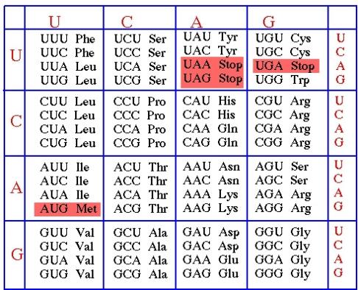
Determining direction and reading frame:
If tryptophan (Trp) is the first amino acid in a protein sequence, you should look for ________ in the DNA.
ACC 3→5 in the coding strand
ACC 3→5 in the template strand
ACC 5→3 in the coding strand
ACC 5→3 in the template strand
TGG 3→5 in the coding strand
TGG 3→5 in the template strand
TGG 5→3 in the coding strand
TGG 5→3 in the template strand
Notes:
Both 2 and 7 are right.

Slide 27
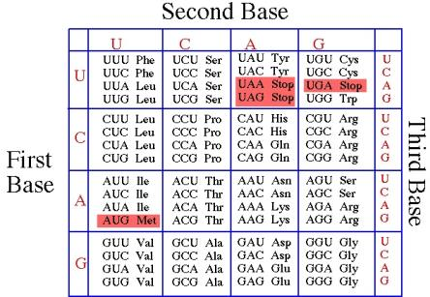
Group work: Which nucleotides are responsible for this particular sequence of amino acids (this sequence of a.a.s comes from the middle of a protein)? Identify the template strand and reading frame.
3’CGTGGTACCAAACCGAGTGGTGAG5’
5’GCACCATGGTTTGGCTCACCACTC3’
TRP-PHE-GLY-SER

Slide 28
College Science Learning Cycle
ENGAGE
EVALUATE
CONSTRUCT

Slide 29
Homework – determine the effect of the mutant on the amino acid sequence and predict the possible consequences for protein function.
Normal #1
#256 GGLAFRVF
5-GGGATTTCTTGGGTGGCCTGGCCTTCCGAGTCTT-3
3-CCCTAAAGAACCCACCGGACCGGAAGGCTCAGAA-5
Mutant #1a, Found in Swiss sisters and their offspring.
5-GGGATTTCTTGGGTGGCCTGGCCTTCCAAGTCTT-3
3-CCCTAAAGAACCCACCGGACCGGAAGGTTCAGAA-5

Slide 30
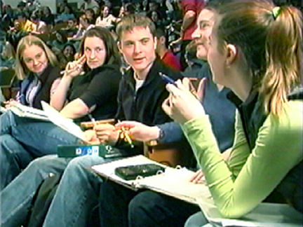
Active learning does take more class time than lecturing
Natural selection acts on individuals, but evolutionary change occurs in the characteristics of a population.
Individuals do not change when they are selected, they simply produce more surviving offspring than other individuals do.
Acclimation occurs when an individual’s phenotype changes in response to changes in the environment, but an individual’s genotype remains fixed, so the changes are not passed on to offspring.
In contrast, adaptation occurs when the allele frequencies in a population change in response to natural selection.
Evolution by natural selection is not goal directed. It simply favors individuals that happen to be better adapted to the environment at the time. Adaptations do not occur because organisms want or need them.
Evolution is also not progressive, meaning producing “better” or more complex organisms. Scientifically, there is no such thing as "higher" or "lower" organisms.
+

Slide 31
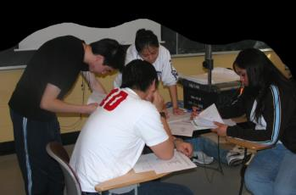
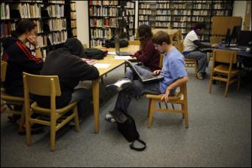
Readjusting
In-Class
Deliberate practice of the most important, difficult concepts and critical thinking skills
  Active learning
  Formative assessment
Out-of-Class
Fact-based content or further practice with class topics or skills
  Online quizzes
  Online tutorials
  Homework
Notes:
Is there some text you could cut from this (but still say) in order to reduce the amount of text on the slide?

Slide 32

Practicing Backward Design
You don’t have to throw away all of your old materials and start from scratch!
Notes:
You can modify the materials you already use.

Slide 33
What is the objective of the activity?
Can the students do it on their own?
Yes.
Is it necessary to
support learning goals?
No.
Is it something students
should figure out?
Yes.
Make it an
out-of-class
activity
No.
Lose it.
Yes.
Ask, Don’t Tell!
Turn into an
in-class activity
No.
Provide as part of
an in-class activity.
Notes:
Ideally, you could animate this one.

Slide 34
Alignment Table
Learning Goal | Desired Learning Outcome | Summative Assessment | Learning activity | Align-ment

Slide 35

In-class activities significantly improved the performance of students on exam questions requiring them to read a graph
Notes:
Data taken from a class in vertebrate physiology in which >90% of the students are biology majors in their senior year. The grades represent averages for 2-3 questions per exam that required students to report the basic findings presented in a line graph. Points represent mean ± S.E.

Slide 36
100
2003 (2 in-class exercises)
2004 (5 exercises)
2005 (8 exercises)
75
2006 (10 exercises)
Grade (%)
50
25
0
pre-test
exam1
exam2
final

