Slide 1
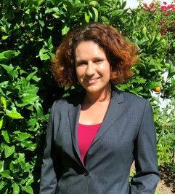
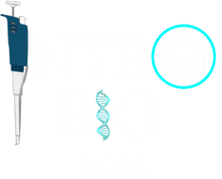


Tailored Messaging for Learning: Supporting Students in Navigating Difficult Concepts
Alice Nguyễn & Maggie Safronova
Biology Leadership Community
April 13, 2025
Office/Department/Division Name

Slide 2
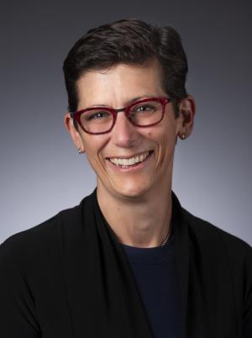
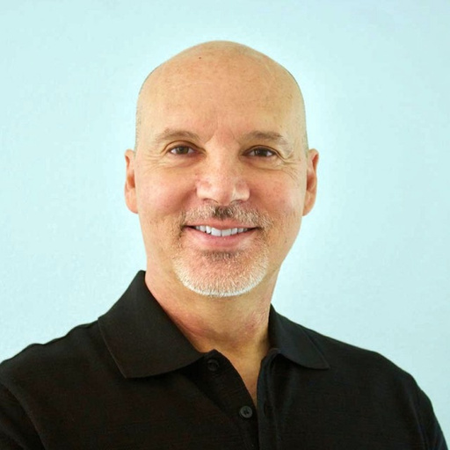
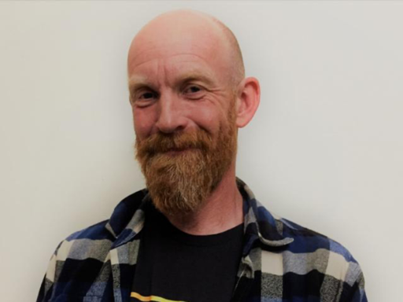

Special thanks to...
Linda Adler-Kassner Associate Vice Chancellor for Teaching and Learning
Thomas Even
Co-Instructor for EEMB 2 (100)
John Latto
Co-Instructor for EEMB 2 (100)
Sayward Halling
Intro Bio Team Member
Office/Department/Division Name

Slide 3
Overview
  Overview of Intro Bio Community
  Collaboration between OTL and EEMB staff and faculty
  Student engagement with messages
  Winter 2025 messaging in introductory biology with a focus on learning outcomes
  Lessons learned and next steps
Office/Department/Division Name

Slide 4

Intro Bio Lecture Series
Fall
Winter
Spring
MCDB 1A
MCDB 1B
EEMB 2
EEMB 3
Biochemistry, Cell Biology, & Genetics
n=~1000
Animal & Plant Physiology*
n=~800
Ecology & Evolution
n=~800
Microbial, Plant, & Animal Diversity
n=~700
  2 offerings Section (100) vs Section (200)
  Section (100): Large enrollment courses without TAs or Discussion
  Section (200): Smaller enrollment courses with TAs and Discussion

Slide 5
Puzzle:
How can we better support students transitioning between introductory biology courses?
  What advice can help students do well in a course beyond study tips and practice problems?
  Can we use tailored messages serve as an alternative to tutoring to help to support student learning?
  How can we incorporate learning outcomes in tailoring student recommendations?
Office/Department/Division Name

Slide 6


Intro Bio Community
Spring
Winter
Tailored Exam prep
Fall
Differences between courses
How to categorize questions
Exam prep
Weekly learning objectives
How to navigate bio:
  Lectures
  Quizzes
  Office Hours
Exam prep
Exam reflection
EEMB 3
MCDB 1B
EEMB 2
MCDB 1A

Slide 7










Content Development: EEMB & OTL Collaboration
1
2
3
4
5
Partnership
Plan
Collaborate
Confirm
Communicate
Confirm the use of Intro BioCommunity eCoach with faculty.
Plan out topics with course coordinator
Work together to draft & revise each message
Regular communication about due dates & content coverage
Communicate on going progress with faculty

Slide 8


EEMB 2 (100) in Context
  Ecology (Thomas Even) and Evolution (John Latto)
  Enrollment ~700 students without discussion sections or TAs
    Diversity in student background and level of preparation
    Feeling lost in a big class
  Common ground between 2 modules
    LOs vs. Bloom’s taxonomy
EEMB 2
Ecology
Evolution
Notes:
ATN: Why is EEMB 2 a good place to start. focusing on (1) how big the class is without typical support structures (i.e. discussion sections and TAs) (2) how to reach students where they are to help support them in the big class (3) make them feel a bit more seen in a large.

Slide 9



How do we customize the messages
  Academic self-efficacy
  Test anxiety
  Bloom’s Taxonomy Score from the first (midterm) exam

Slide 10
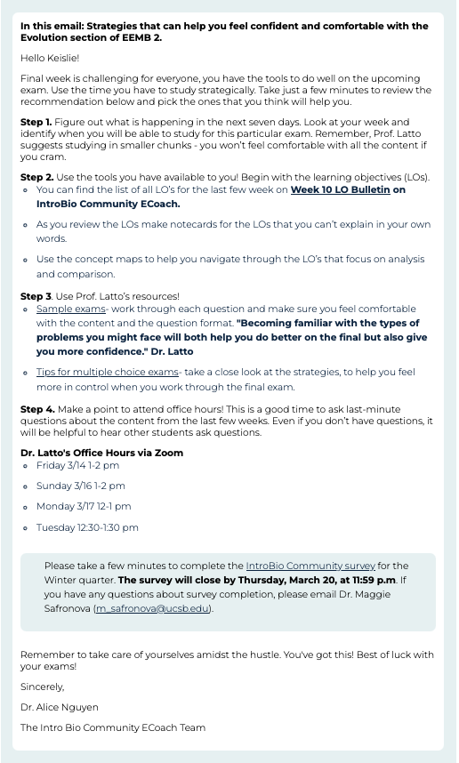
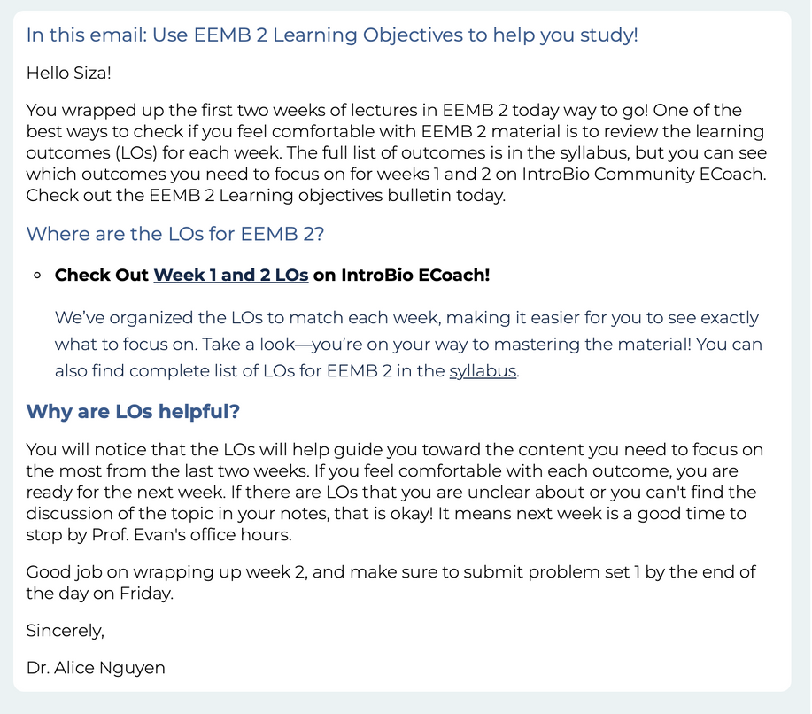
Emails

Slide 11
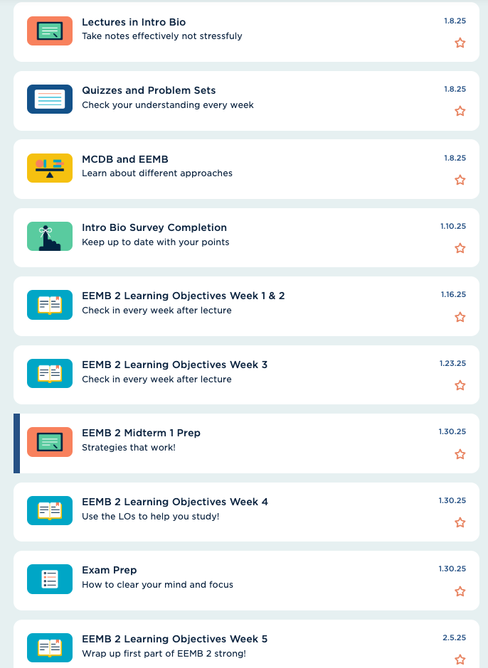
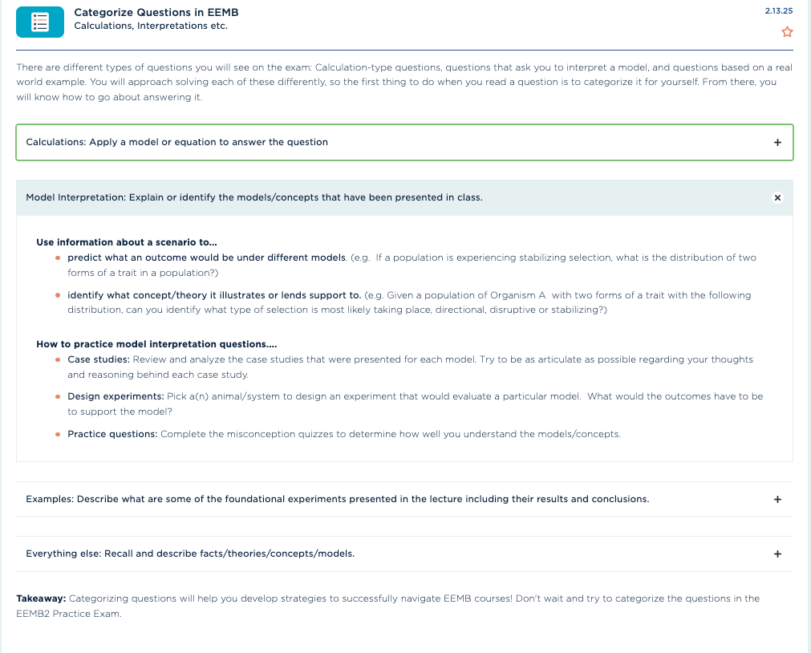
Bulletins

Slide 12
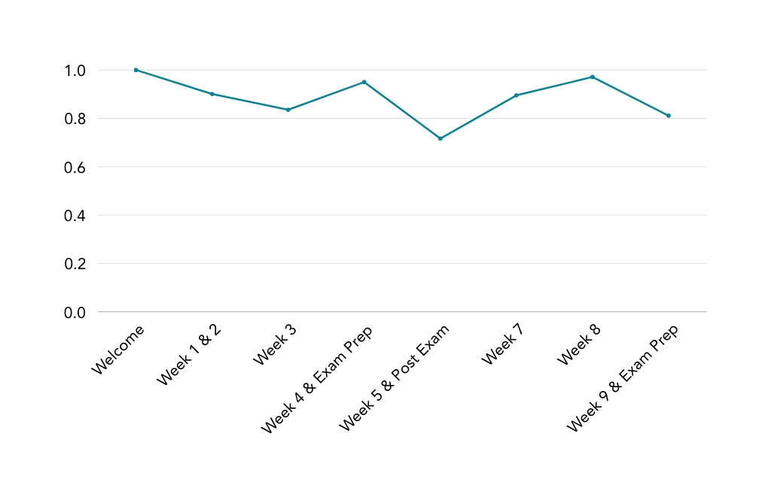
Student Engagement in EEMB 2
  On average, 89 % of students open emails throughout the quarter
  Less than 20% of students review LO bulletins.
    So, we changed our strategy as we got closer to the final exam
Percentage of Students that Opened Emails
% of Students Opened Email
We need to be realistic about the amount of time and the cognitive load for students
Emails messages
Notes:
Suggest that following links on emails to more resources may be too much in terms of cognitive load. However, we can take advantage of the fact that they regularly open emails to put the content/resouces directly into the emails.

Slide 13



Faculty Engagement
  Role of emails in the course
  Opens discussion about learning objectives
    Collect and present data to faculty about how students interact with resources compared to exam performance.
    Identify LOs or question types that are challenging for students.
    Connections between LOs and Bloom’s Taxonomy
  Undergraduate PLO assessment
    Means to assess PLO covered in the course
    Inform instructors of subsequent courses student behavior
Notes:
ATN: show how intro biocommunity ecoach can provide useful information for faculty and a means to collect data about specific things they are interested in.

Slide 14
Lessons Learned
  Utilize email as the key messaging mechanism
    Set-up drafts of messages before the beginning of the quarter to minimize last-minute edits.
  Small incentive (~1%) significantly increases student engagement with resources.
  Publication of resources needs to align not only with course schedule but also exam schedules in other courses (e.g. MCDB 1B and Organic Chemistry)
Notes:
ATN:

Slide 15
Next Steps
EEMB 3
  Reduce number of Emails with strategic publishing week before exam
  Tailor messages on Bloom’s scores from the final in EEMB 2 for first exam in EEMB 3
IntroBio eCoach Community
  Explore relationship between particular Bloom’s level questions scores across all exams in the series.
  Compare between Section 100 & Section 200 for each course.
Notes:
ATN

Slide 16
Thank you!
Notes:
15

Slide 17
Office/Department/Division Name

