Slide 1
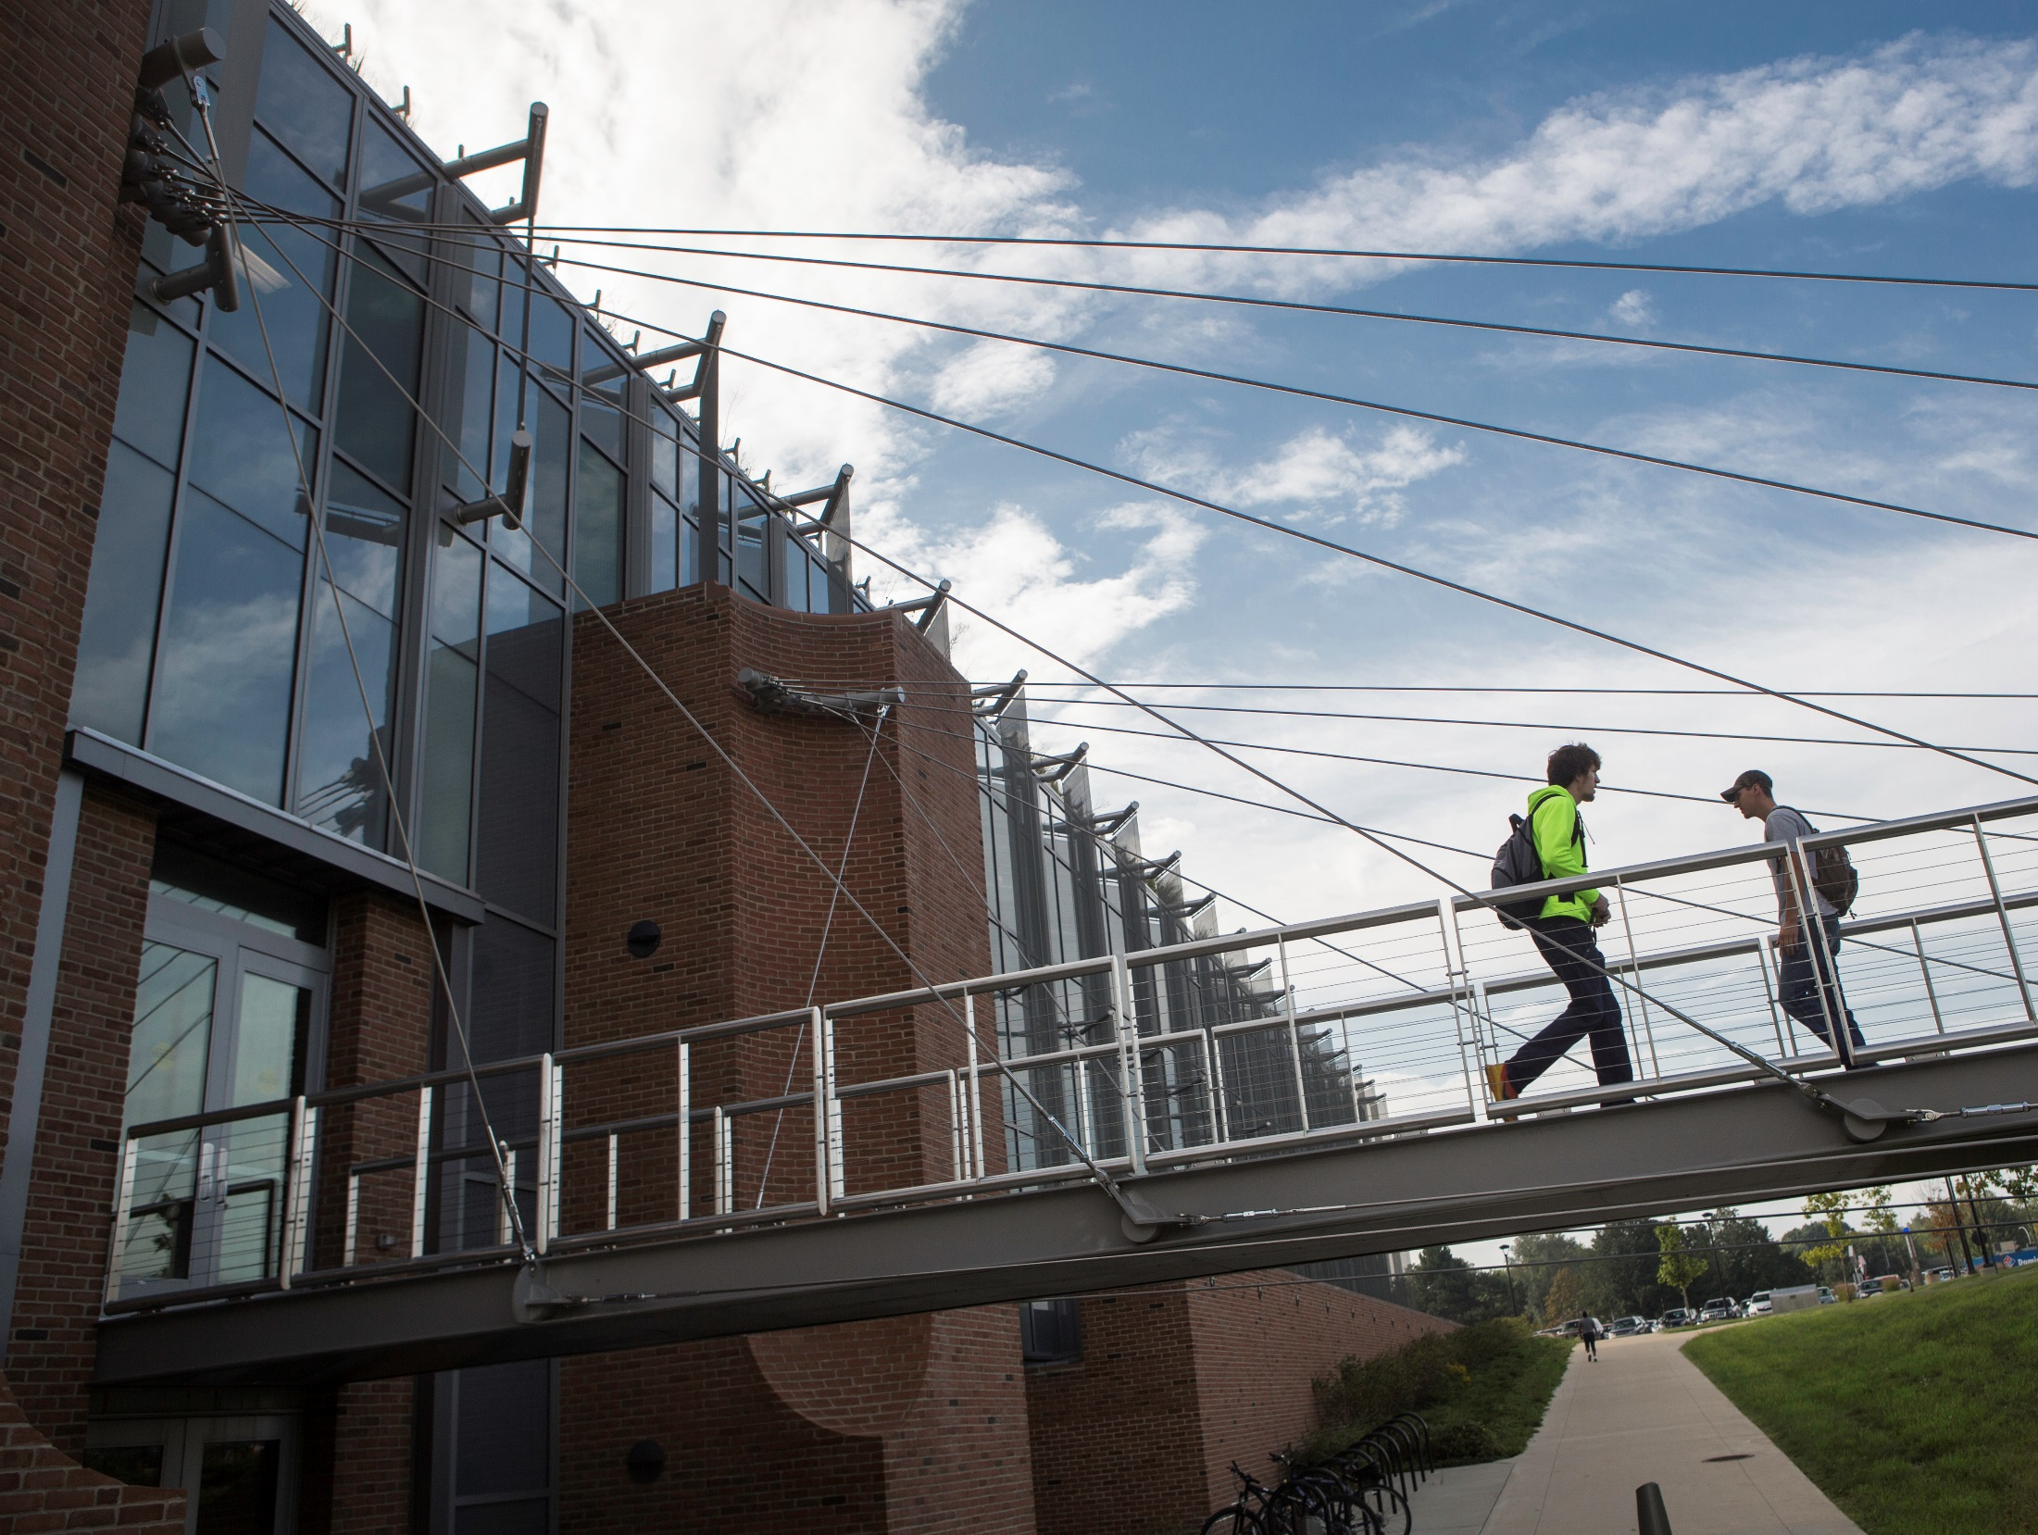
Vertical Non-Permanent Surfaces and Visibly Random Groups in Intro Bio Lecture and Lab
Anne Casper, Ph.D.
Eastern Michigan University

Slide 2

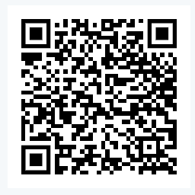
BIO 110 at
Lecture + Lab course
Lecture enrollment = 60 per section (multiple sections)
Content:
  Biological molecules
  Energy
  Cell structure/function
  Cell division
  Genetics
  Evolution
Access my syllabus, etc.

Slide 3
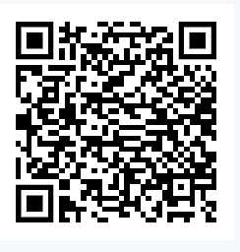
My class, 2016 – 2022
Before class:
  Assigned video (15 min)
  List of potential quiz Q
Begin every class with WU quiz
  Two questions from the list
  Hand-written
  Closed book, closed notes
  Graded in class by students
  GA or SI alphabetizes after handed in
True Grit: Passion and persistence make an innovative course design work
AM Casper, SL Eddy, S Freeman
Access my WU quiz questions and pre-class videos

Slide 4
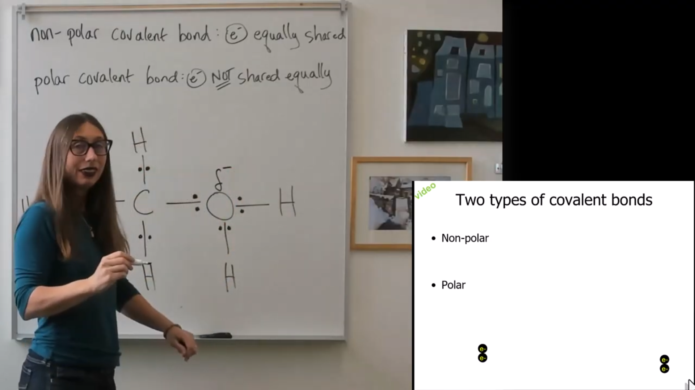
Screen still from a pre-class video
Access my WU quiz questions and pre-class videos

Slide 5
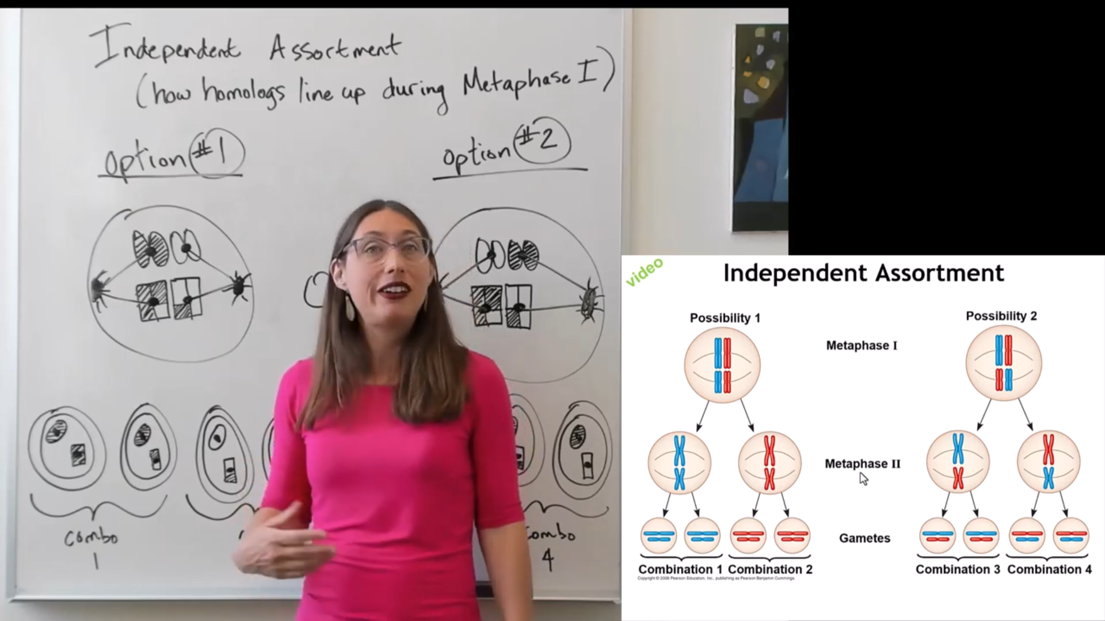
Another screen still from a pre-class video
Access my WU quiz questions and pre-class videos

Slide 6
My class, 2016 – 2022
Before class:
  Assigned video (15 min)
  List of potential quiz Q
Begin every class with WU quiz
  Hand-written
  Closed book, closed notes
In class:
  3-5 clicker questions, students answer alone first
  Many worksheets and activities, at seats with neighbors
  Many questions by me, random warm calling
Weekly online post-class homework
True Grit: Passion and persistence make an innovative course design work
AM Casper, SL Eddy, S Freeman
Access my WU quiz questions and pre-class videos

Slide 7
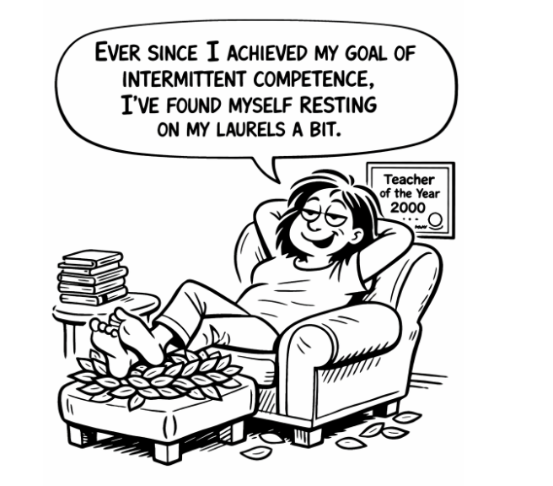
Cartoon created with ChatGPT

Slide 8
On Thu, Apr 14, 2022 at 4:23 PM acasper2@emich.edu wrote:
Hi SABER colleagues,
What are your favorite books about active learning?
I'm looking for some summer reading!
Apr 14, 2022, 7:39 PM
I've been doing active learning for years and "Building Thinking Classrooms in Mathematics" by Peter Liljedahl blew my mind. The book has little tweaks to active learning practices that fix some of the common challenges. I implemented some of the practices this year, and so did another professor with a lot of prior experience with active learning. Neither of us teach math, but the principles and practices can work with other subjects. Also, some things would be hard to implement in large classrooms, but it would be fun to discuss how it might be done!
-- Cathy Ishikawa

Slide 9
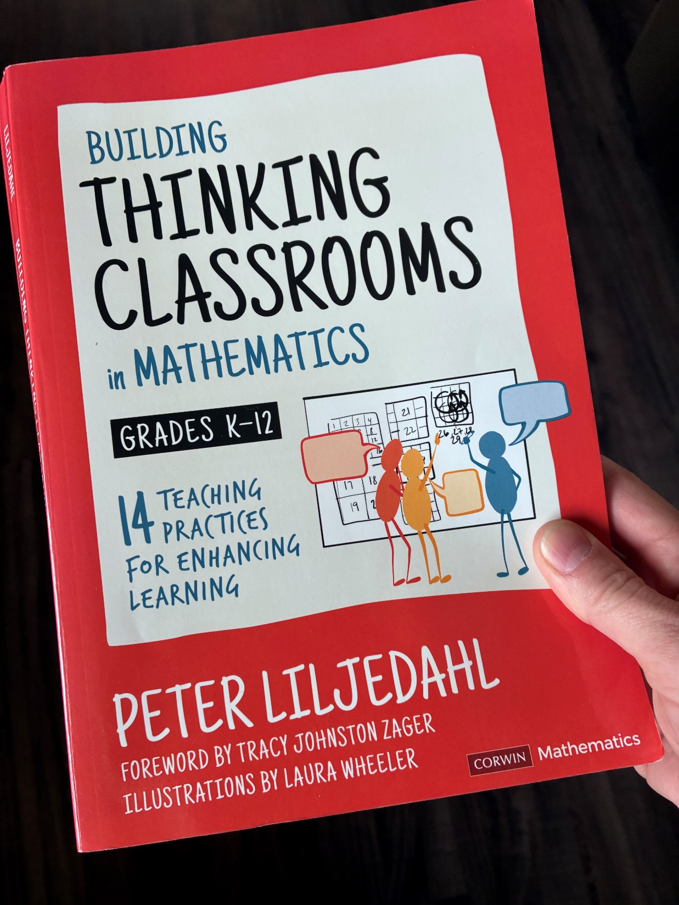

Slide 10
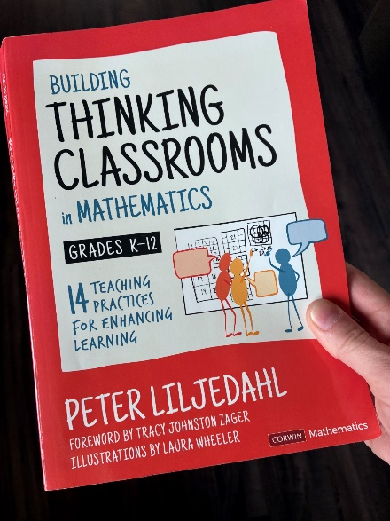
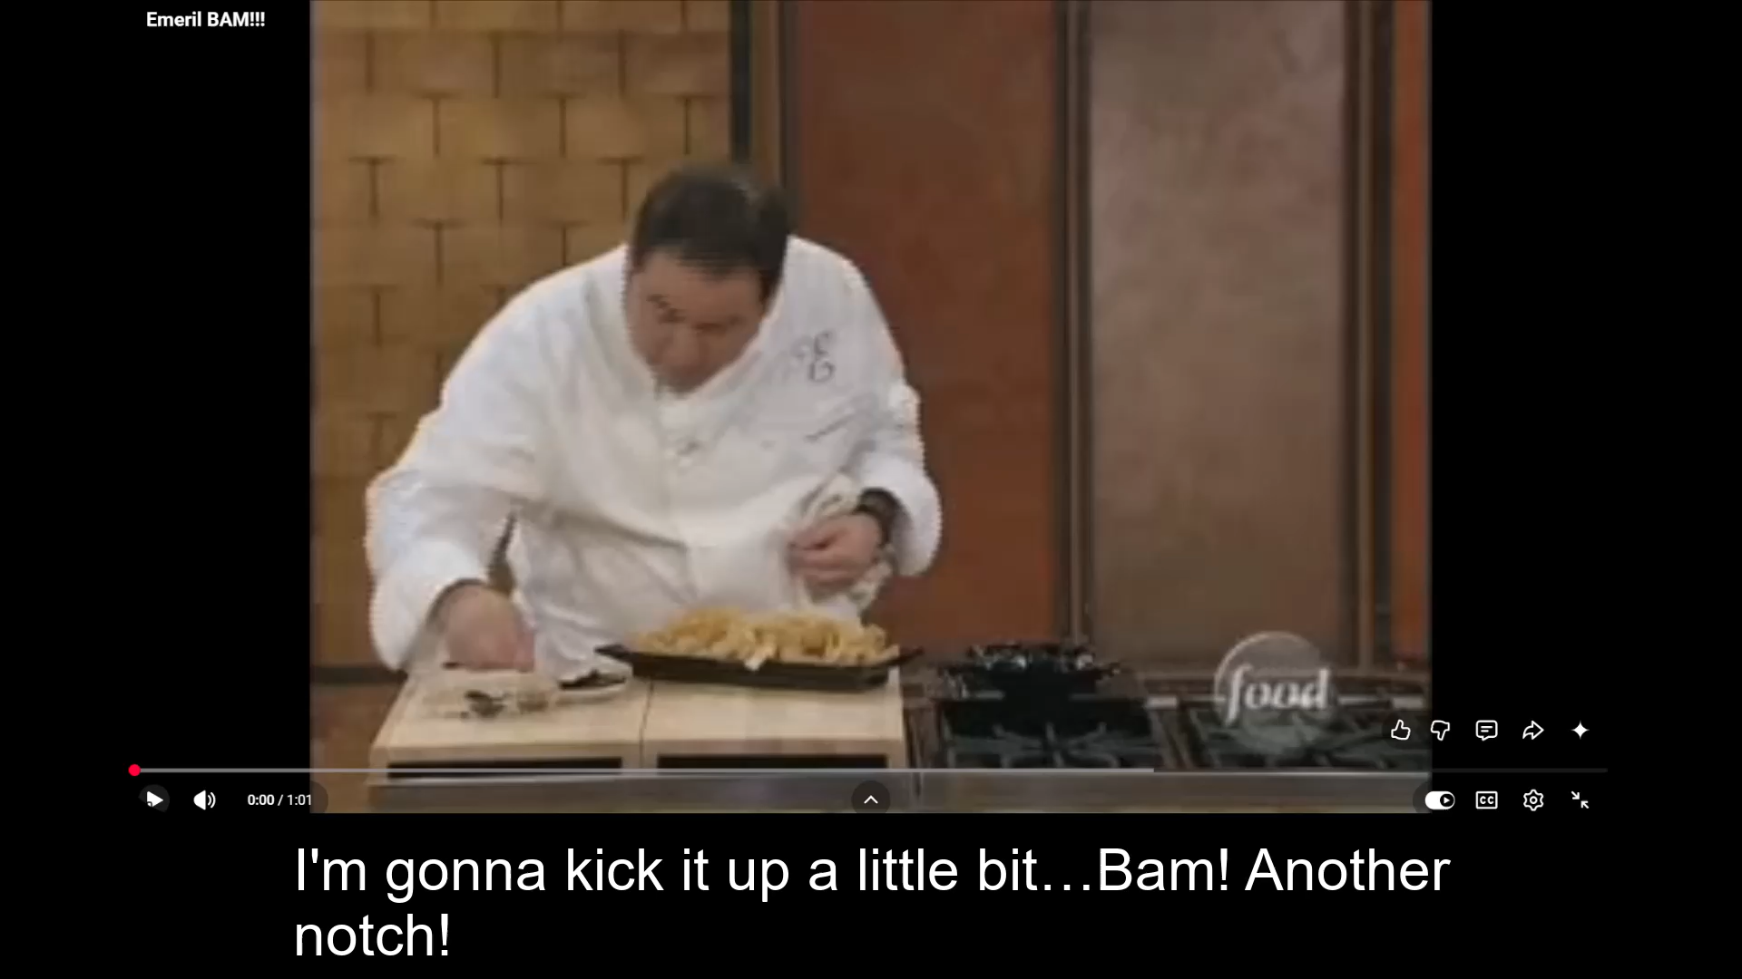

Slide 11
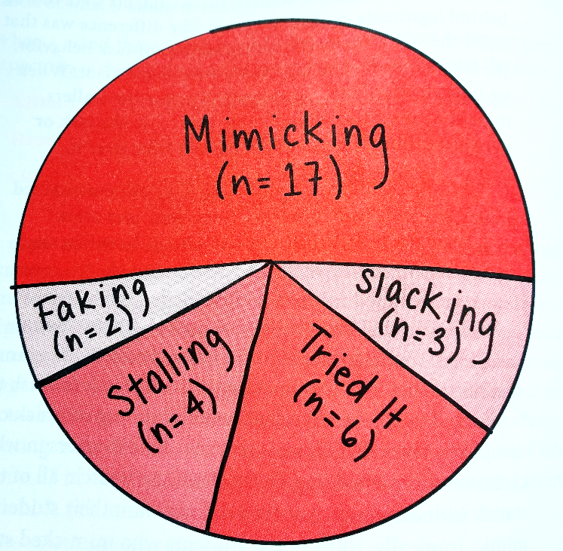

2016 – 2022
Student behaviors in K-12 math classrooms during in-class work on an activity (Liljedahl book)
What do your students do during in-class work time on an activity?
In class:
  3-5 clicker questions, students answer alone first
  Many worksheets and activities, at seats with neighbors
  Many questions by me, random warm calling
Weekly online post-class homework
Access my WU quiz questions and pre-class videos

Slide 12
How I changed my class
Before class:
  Assigned video (15 min)
  List of potential quiz Q
Begin every class with WU quiz
  Hand-written
  Closed book, closed notes
In class:
  3-5 clicker questions, students answer alone first
  Many worksheets and activities, at seats with neighbors
  Many questions by me, random warm calling
Weekly online post-class homework
Visibly random groups working at
Vertical Non-Permanent Surfaces (VNPSs)

Slide 13
Let’s talk about in-class groups
What problems arise when students choose their own groups for in-class work?
What problems arise when the teacher assigns students to a group for in-class work?

Slide 14

There are many benefits to frequently forming visibly random groups
After 3 weeks:
Increased number of students who offer an idea during group work
Increased willingness to work with any student
Reduced students’ social stress
Increased awareness of other students
Increased knowledge mobility between groups
Image from Liljedahl book

Slide 15
Let’s experience it!
Pearson people = GAs
Meeting invitees = students
GAs, please shuffle your deck and then give a playing card to each student
Students, when you get your playing card, please go to the vertical surface it assigns you

Slide 16
On your vertical surface:
Draw a HUGE rectangle. This is the plasma membrane of a eukaryotic cell in cell cycle phase G1
Add a nucleus (make it large!)
Add one pair of homologous chromosomes
Add a gene (gene A)
Indicate the allele on each chromosome, assuming that the cell comes from a person who is homozygous recessive
Access more examples of thinking questions I use

Slide 17
On your vertical surface:
Draw a HUGE rectangle. This is the plasma membrane of a eukaryotic cell in cell cycle phase G1
Add a nucleus (make it large!)
Add one pair of homologous chromosomes
Add a gene (gene A)
Indicate the allele on each chromosome, assuming that the cell comes from a person who is homozygous recessive
Add a second pair of homologous chromosomes
Add a gene (gene B) to this pair of chromosomes
Indicate the allele on each chromosome, assuming that the cell comes from a person who is heterozygous
Below the cell, indicate the genotype of the individual for both genes
Access more examples of thinking questions I use

Slide 18
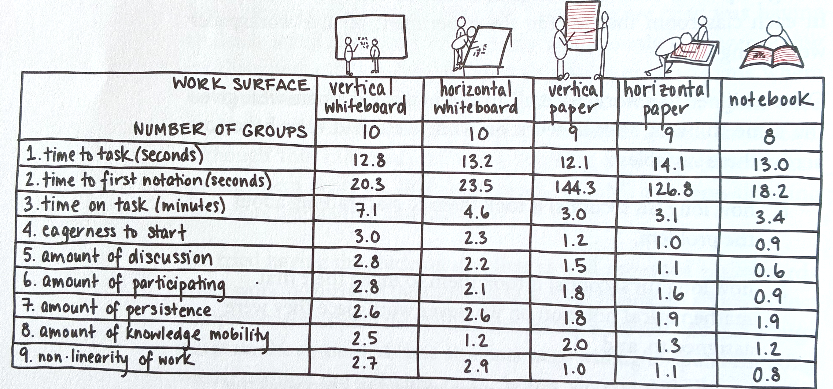
Would you have preferred a whiteboard for the activity we just did?
Data from K-12 math classrooms (Liljedahl book)

Slide 19
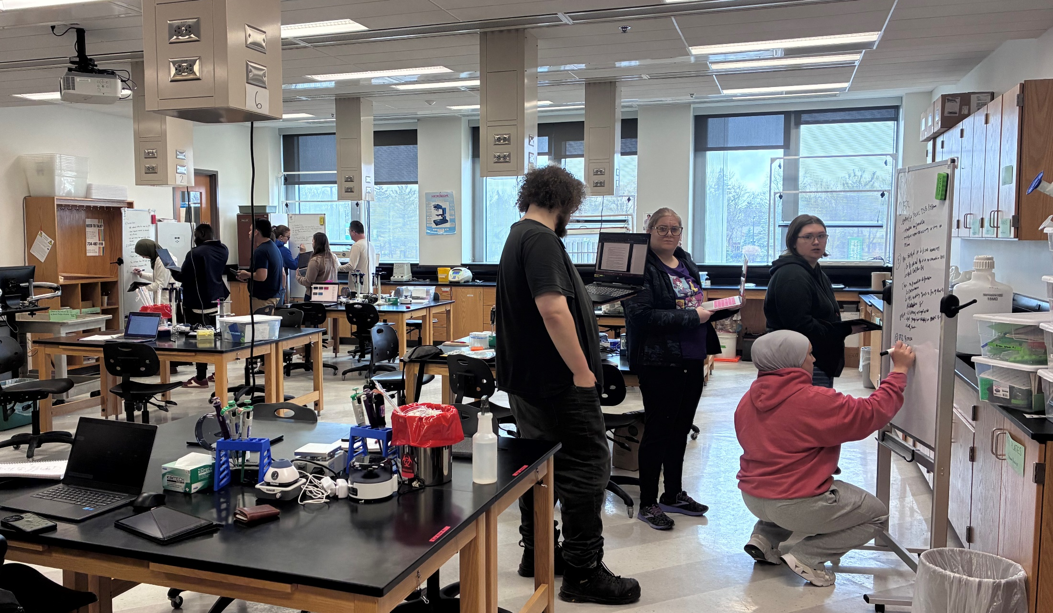
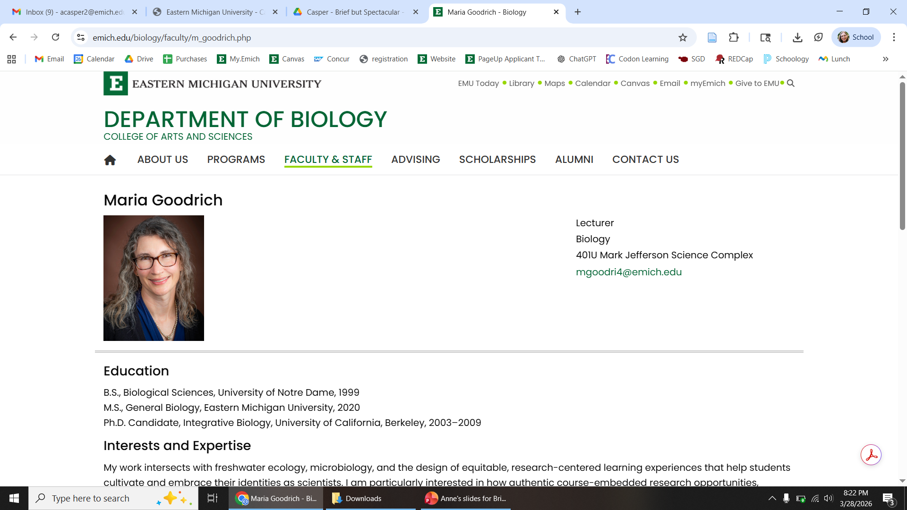
What about in lab classes?
Yes! I added VNPS and random groups to lab
  Smaller rolling whiteboards
  Student comments are positive

Slide 20
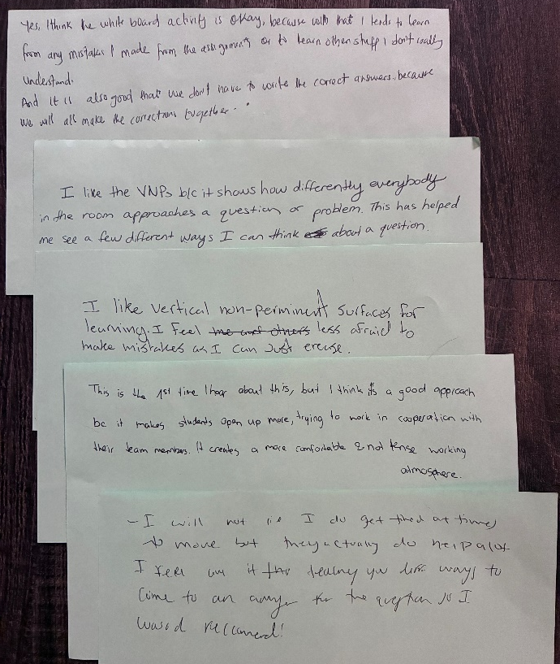
Yes, I think the white board activity is okay, because with that I tend to learn from any mistakes I made from the assignments or to learn other stuff I don’t really understand.
And it is also good that we don’t have to write the correct answers, because we will all make the corrections together.
I like the VNPs b/c it shows how differently everybody in the room approaches a question of problem. This has helped me see a few different ways I can think about a question.
I like the vertical non-permanent surfaces for learning. I feel less afraid to make mistakes as I can just erase.
This is the 1st time I heard about this, but I think it’s a good approach bc it makes students open up more, trying to work in cooperation with their team members. It creates a more comfortable and not tense working atmosphere.
I will not lie I do get tired at times to move but they actually do help a lot. I feel like it teaches you different ways to come to an answer for the question so I would recommend!

Slide 21
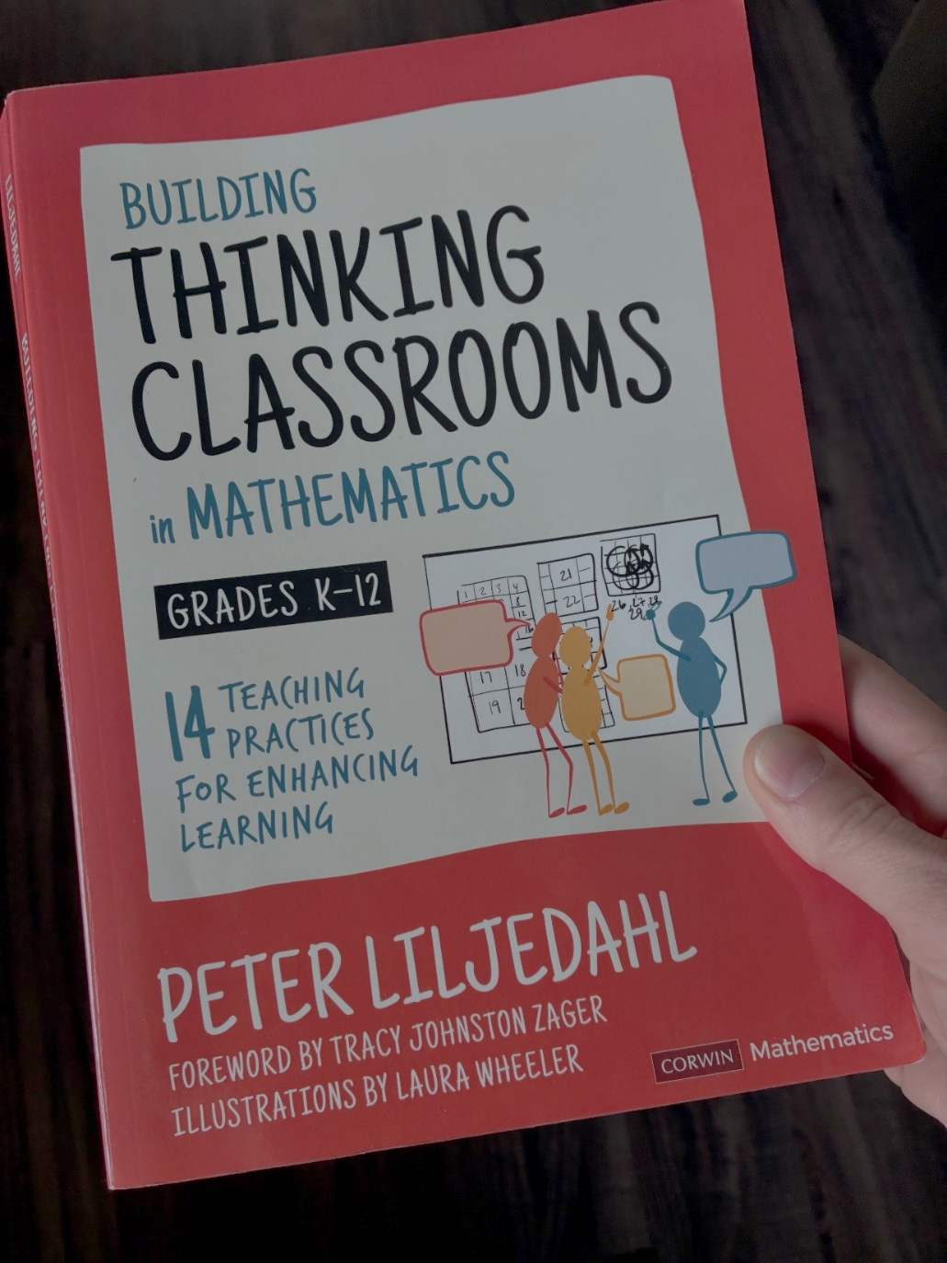
There’s so much more in the book
Writing “thinking questions”
How we answer student questions during activities
How we foster student autonomy
How we consolidate after an activity
How students take notes

Slide 22
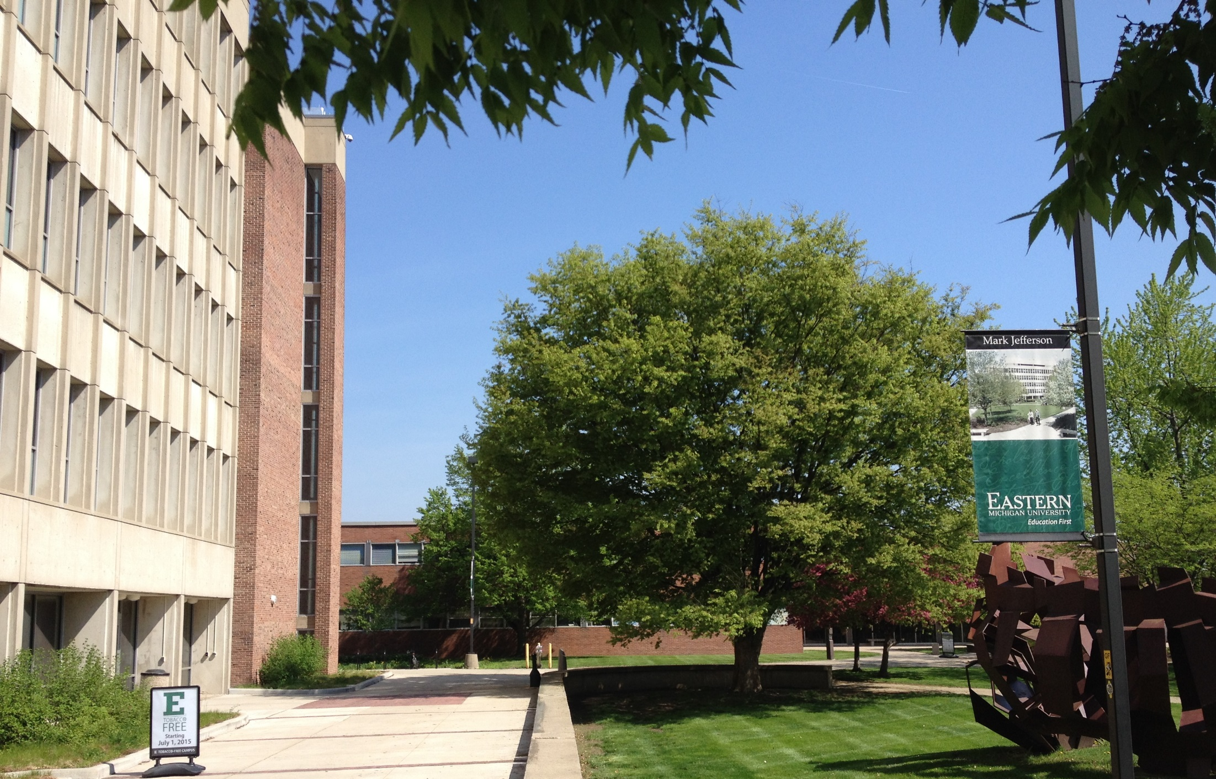
Kick your class up a notch!
Switch to using frequent, visibly random groups
Fill your classroom with vertical, non-permanent surfaces
We should assess whether this is as successful in college biology as Liljedahl found for K-12 math. Want to join me in a Catalytic Grant proposal?
Thank You!

