Slide 1

Saddle up Biology
A pre-matriculation course experience to improve student success
John Willford, PhD. & Jonathan Prather, PhD
^{University of Wyoming}

Slide 2
Uwyo Common issues in Gen Bio
Transition from high school to college can be challenging
  Study skills, time management, initiative/motivation
Time on task, finding ways to apply/practice content
  Depth of knowledge and connecting across different contexts
Difficulty with growth mindset and shift to engaging to learn well instead of a transactional grade mentality
  Uncertainty about how to do this as a novice learner
These are also common themes in other large, introductory courses

Slide 3
Said in another way…
Have difficult in both identifying WHAT they need to learn and HOW to do it effectively
  Often, students need to figure out the “shadow curriculum” of being successful in college, in addition to the true curriculum in the course
May not receive or internalize feedback about the issues on previous slide until a high stakes assignment
  Often note that many students are playing with Monopoly money until the first exam
Not surprisingly, these issues (among others) have an impact on success and retention at UWyo

Slide 4
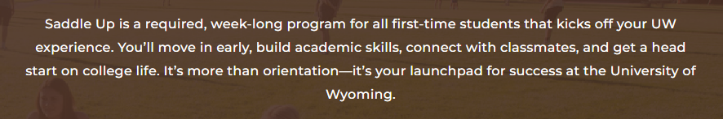
University of Wyoming Saddle Up
First cohort was our incoming class of 2022
Includes a week-long course experience intended to introduce students to academic best practices
  Two colleges wanted the class to be based on General Biology

Slide 5
Saddle Up Course
Student learning outcomes – Centrally required by UW
  Students are developing a sense of community at UW.
  Students demonstrate the ability to navigate coursework.
  Students are able to establish study skills.
  Students are able to identify and access UW resources.
Course should be designed to “simulate a midterm week”
  Needs to include an exam or equivalent cumulative project
To pass: complete academic and experiential requirements

Slide 6
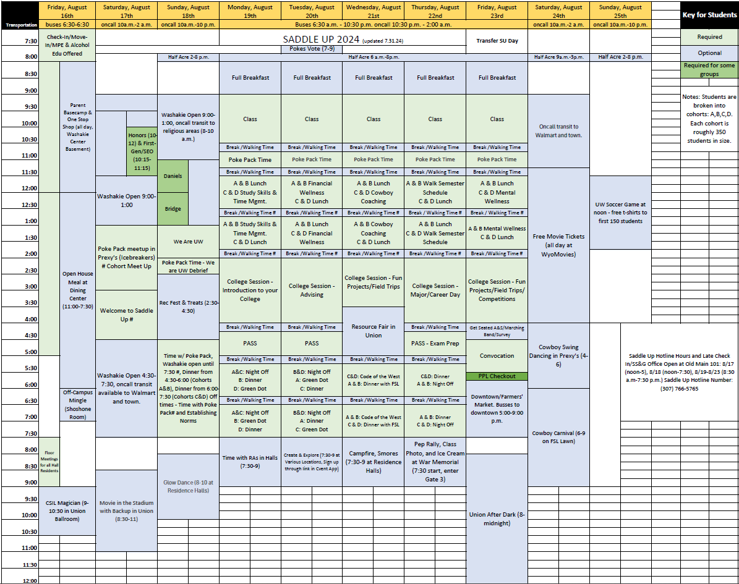
Multifaceted Schedule
Green elements: required
Blue elements: optional
Exam is expected to be Friday morning
  4 days of instruction
  Last day for exam & wrap-up

Slide 7
Four days of Instruction
Build to cellular respiration
  Cell membranes & movement across membranes
  Cell organelles
  Biological energy
    No enzymes ☹
  Cellular respiration
Reasons for this progression of content

Slide 8
How do we do this
Have 90 minutes for each class period
Spend ~50 min teaching content
Spend ~40 min pulling back the curtain
  Why we do things the way that we’ve set them up
  Pros/cons of different pedagogical approaches to look out for
  Advice from many years of student interaction
  Wellness discussion – tied to exam prep
Friday – discuss exam and then open the floor for Q&A

Slide 9
Activities/assignments
In-class formative student response questions (not graded)
  Monday-Thursday
In-class summative small group application
  Monday-Thursday
Evening homework
  Due Wednesday evening
End of week exam (on canvas)
  Friday
To pass: submit exam, submit 4 of other 5 assignments

Slide 10
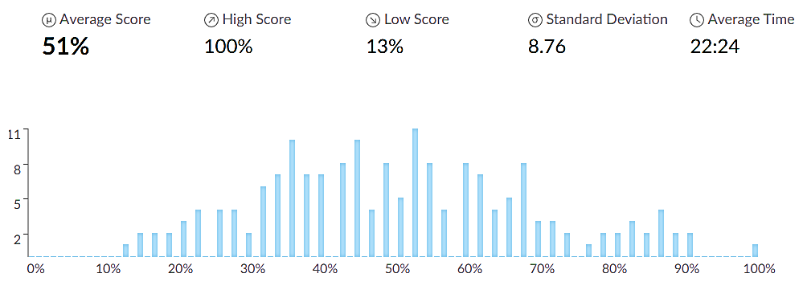
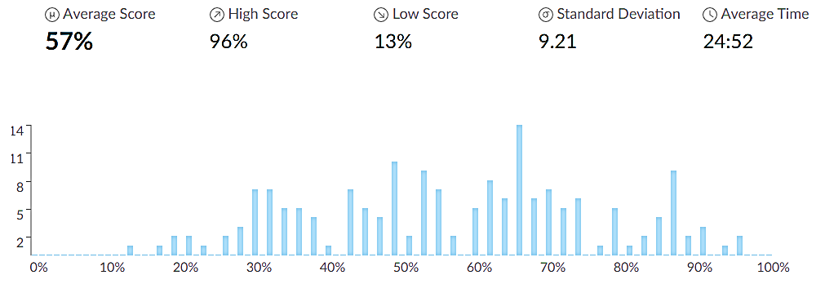
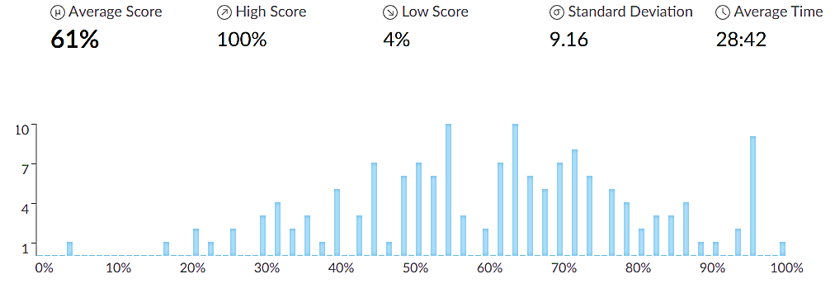
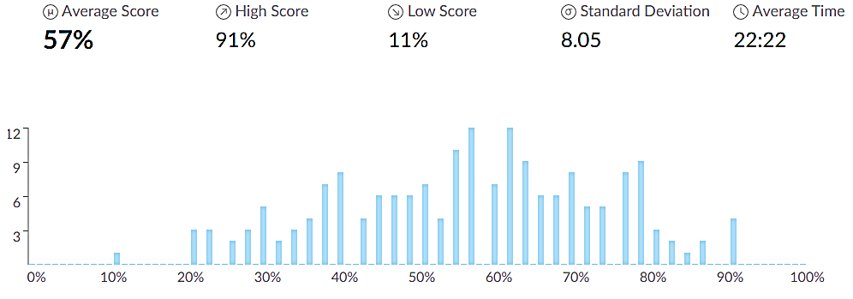
End of Week Exam results
2022
2024
2023
2025
Exam taken on canvas with exam questions from when we offered Gen Bio online during COVID years that cover content from the week

Slide 11
Sample Friday student Questions
Is it possible to retake exams??
How do labs work? Are there times when we will not have labs or have labs when we are not expecting them?
Is every test more about application than memorization? Or just for biology?
When is the most appropriate time to introduce yourself to the professor and make a good first impression?
Was this test a pretty accurate representation of what a test covering that amount of material would look like in gen bio?
How did you decide on your career?
How do I learn material and not memorize?
Is taking chem, bio, and a math at the same time a bad idea?
Drake or Kendrick?

Slide 12
Selected Student feedback
I loved this course during saddle up. It helped me a bunch with some of the worries I had about coming to college and starting classes.
The course was very short but he made it fun, and a perfect demonstration of what college classes would look like. Even the homework he assigned was accurate to classes now.
During Saddle Up, this was a very helpful starting course, I felt very prepared to go into my actual Bio class. He was very interactive and kind.
With this class during saddle up it taught me a lot about how an actual class would look like. It also helped me not be as nervous going to class the next week.
I liked that he interacted with us as students instead of just lecturing at us. I really liked that saddle up did this for us, so we could see how a big lecture hall type of class would look like.

Slide 13
Not Universally loved…
Dr. Willford is a nice guy. He seemed very energetic and wanted us to all do well in college. But Saddle up was honestly a waste of time for me especially since I was in the marching band. It made me tired for when actual school started. I was also very mad that I had to pay for it even though I missed over half of it due to band. I do not think it should be mandatory. It just stressed me out even more.
HATE SADDLE UP WASTE OF TIME AND MONEY. Dr. Willford helped to get through it with his pep talks.
This honestly felt rather pointless to me, as many students coming in have taken college courses. I really liked the professor, but saddle up felt long and dragged out with random unscheduled breaks that weren't long enough for anything productive.
I never had John Willford as a professor

Slide 14
…But seems to help - University Data
Blue line: implementation of Saddle Up
Red line: COVID
  * Fall 2019 matriculants “returned” to online class with no academic probation or suspension on campus
First-time, full-time student data
  No biology-specific data ☹
*
Not the magic bullet that some imagined this to be, but improving outcomes
Students who continue best practices show higher fall-to-fall retention rates
  For example, those who meet with peer Cowboy Coaches 2x during the year – 88% retention

Slide 15
Questions?
John Willford
University of Wyoming
Willford@uwyo.edu

