Slide 1
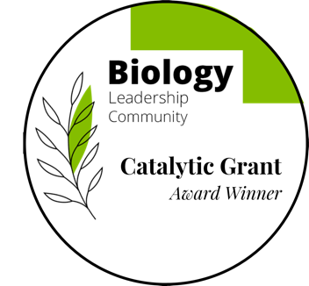





Examining the Impact of Integrating GenAI Tools on Engagement & GenAI Perceptions in Biology Courses Across Four Campuses
Dr. Gokhan Hacisalihoglu @Florida A&M University (FAMU)
Dr. Cerrone Foster @East Tennessee State University (ETSU)
Dr. Jennifer O’Neil @Houston Community College (HCC)
Dr. Andy Baldwin @Mesa Community College (MCC)
FAMU IRB Approved
Procol #021-24

Slide 2
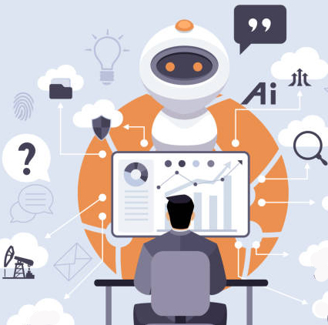
LIT. REVIEW: GENAI.
What are its merits & limitations of GenAI? How can it enhance teaching / learning Biology?
1950:Modern AI emerged: when Alan Turing posed, “Can machines think?” (Turing, 1950).
1956: Followed by John McCarthy’s naming of “artificial intelligence”.
1990s: Machine learning→ enabling AI to learn from data
2010s:Deep Learning→ with neural networks emulating human cognition
2022: generative AI released→exemplified by OpenAI’s GPT-3 and ChatGPT—has produced human-like text, transforming fields from healthcare to education (Spitale et al., 2023)

Slide 3

GENAI.BENEFITS/CHALLENGES
GenAI tools like ChatGPT provide instant student support, amplifying instructors’ reach
Overreliance on AI →may risk undermining critical thinking
Access disparities→unreliable internet or devices—risks implementation (Means et al., 2020)
Increasingly difficult to distinguish between student work and machine-generated output
Educators→can redesign assessments that emphasize critical thinking, creativity, and problem-solving…
------reflective portfolios, oral presentations, collaborative projects that require students to engage deeply with the material

Slide 4
GENAI.
A number of studies on ChatGPT indicate that Gen AI-assisted learning enhances higher-order thinking skills in education (Lee et al. 2024) but also produced repetitive responses and lack of depth (Gopal et al., 2024). However, Callahan et al. (2023) showed benefits in using GenAI such as learning support and brainstorming but challenges with accuracy, transparency, privacy, and ethics
AI as a Virtual Tutor: 24/7 support (Explain feature)
Creative Exploration: e.g., MidJourney can foster innovation.
Personalized Feedback: e.g., Grammarly for feedback
Our Study: GenAI in action at 4 campuses (FAMU, ETSU, HCC, MCC) into Majors Biology courses to amplify SLOs
Gopal et al. (2024) Comparative Analysis of Generative Pre-Trained Transformers Responses to Coastal Ecosystem Questions: Implications for GenAI in Environmental Education
OpenAI (2023) ChatGPT: An advanced AI language model for text-based interactions. https://openai.com/chatgpt
Spitale G, Biller-Andorno N, & Germani F (2023) AI model GPT-3 (dis)informs us better than humans. Science Advances, 9(5): Article eade7823.
Turing AM (1950) Computing machinery and intelligence. Mind, 59(236): 433–460.

Slide 5
RESEARCH OBJECTIVES:
The purpose of this project is to implement GenAI-based tools in online and in-person general biology lecture courses. The specific objectives are:
To develop best practices and guidelines on the ethical use of GenAI tools for students by facilitating the development of a student-led GenAI usage policy in each class
To design and integrate three GenAI-based assignments into general biology courses across multiple campuses and modalities that scaffold from lower level Bloom’s skills (memorization, comprehension) to upper level skills (data analysis, etc) and examine students perceptions on the usage of GenAI in class.

Slide 6
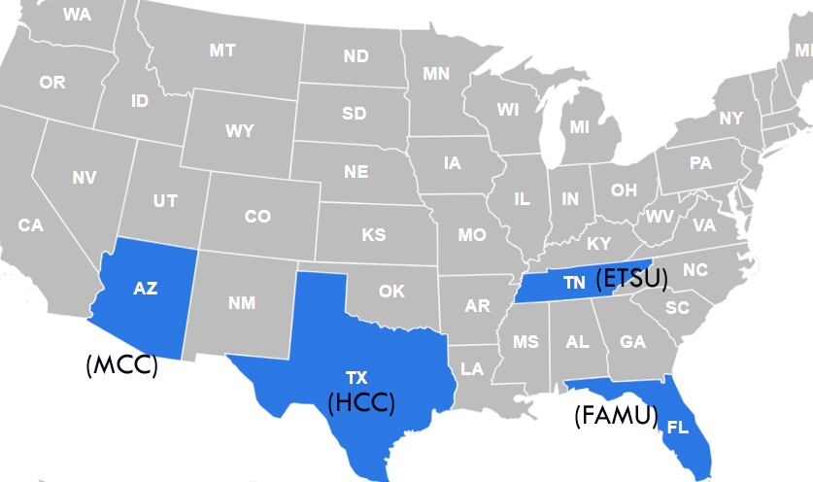
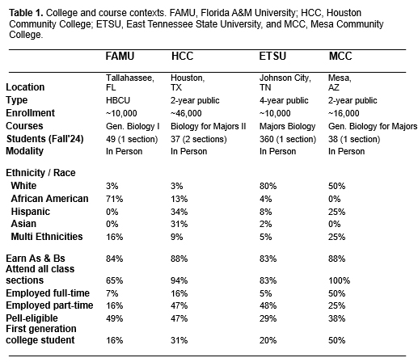
METHODS
Pre & Post surveys on students’ past experiences with GenAI were developed and implements to examine student perceptions of GenAI ethical use in education and how it should be used in education in the future. Students were given three GenAI assignments during the semester
GenAI #1
AI Literacy PPT + Quiz
Gen Bio I (FAMU)
GenAI #2
AI Study Guide + Reflection
Gen Bio I (ETSU)
Post-Course Survey
Pre-Course Survey
Gen Bio Majors (MCC)
Gen Bio II (HCC)
GenAI #3
Dev. AI Quiz or AI Paper Analysis
FAMU IRB Approved
Procol #021-24
Figure 1. Study design for implementation of GenAI assignment in four Introductory Biology courses.

Slide 7

Item | Pre Survey Questions (Select)
8 | Have you ever used Generative AI (Gen AI) (Chat-GPT, Copilot, Bing Chat, etc.)?
9 | Are you in any other courses that expressly encourages or allows the use of Gen AI?
12 | Select the choices that best describe how you use the information collected from Gen AI (Chat-GPT, Copilot, Bing Chat, etc.)
16 | In your perspective, what are the benefits of GenAI in education? Select all that apply.
17 | What guidance or services should a university/college provide about using Gen AI?
18 | What, if any, concerns do you have regarding Gen AI in the classroom?
 | Post Survey Questions (Select)
22 | When using AI answer how often do you look up additional information to be sure results are correct?
24 | Did using AI make it easier to read or comprehend your textbook?
25 | Gen AI Assignments in this course were useful and increased content engagement for me.
26 | Did using Gen AI in class make it easier to read, or follow along or engage in class activities?
27 | What aspects of the Gen AI Assignments did you find the most helpful for your coursework?

Slide 8
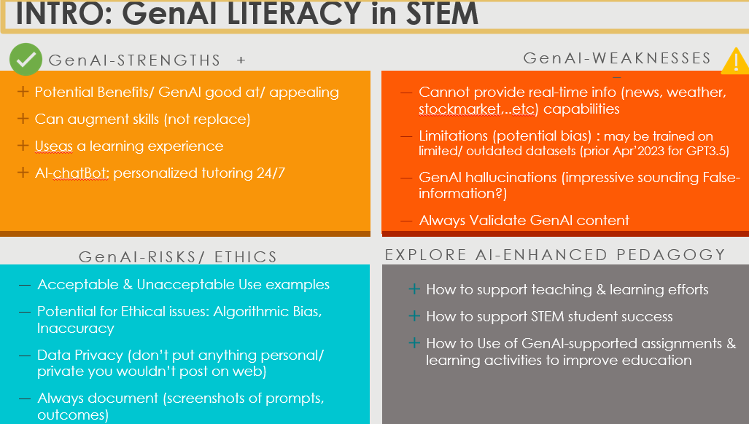
GenAI LITERACY (in class)

Slide 9
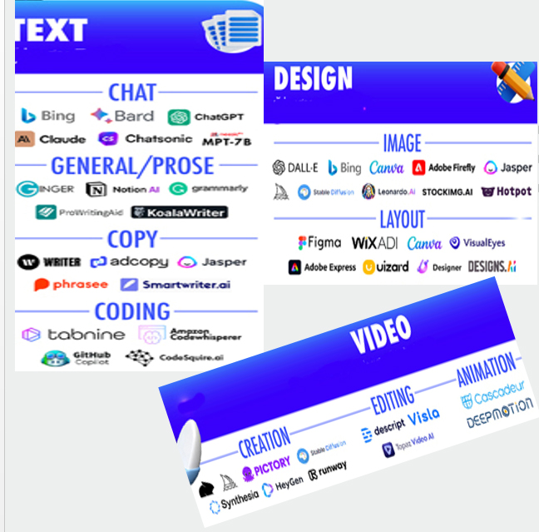
GenAI TOOLS
GenAI: software apps designed to respond text Qs (prompts) with Outputs. Potential applications include:
Brainstorming ideas
Summarize articles
Generate Research Qs/ hypothesize
Personalized tutoring (answer Qs, feedback)
Generate art,……

Slide 10
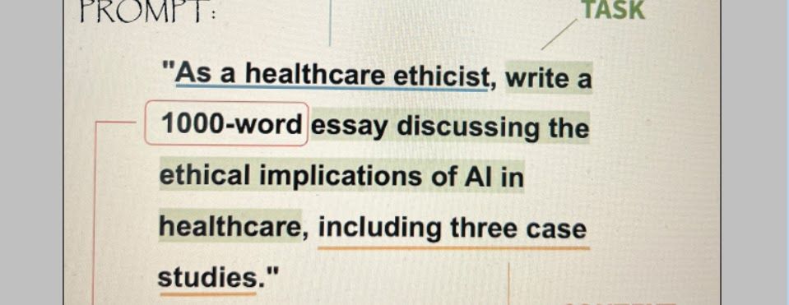

GenAI PROMPTS
→create a pic of a sportscar driver wearing a chicken suit
Split complex tasks (step by step/ split prompts First, Second)

Slide 11
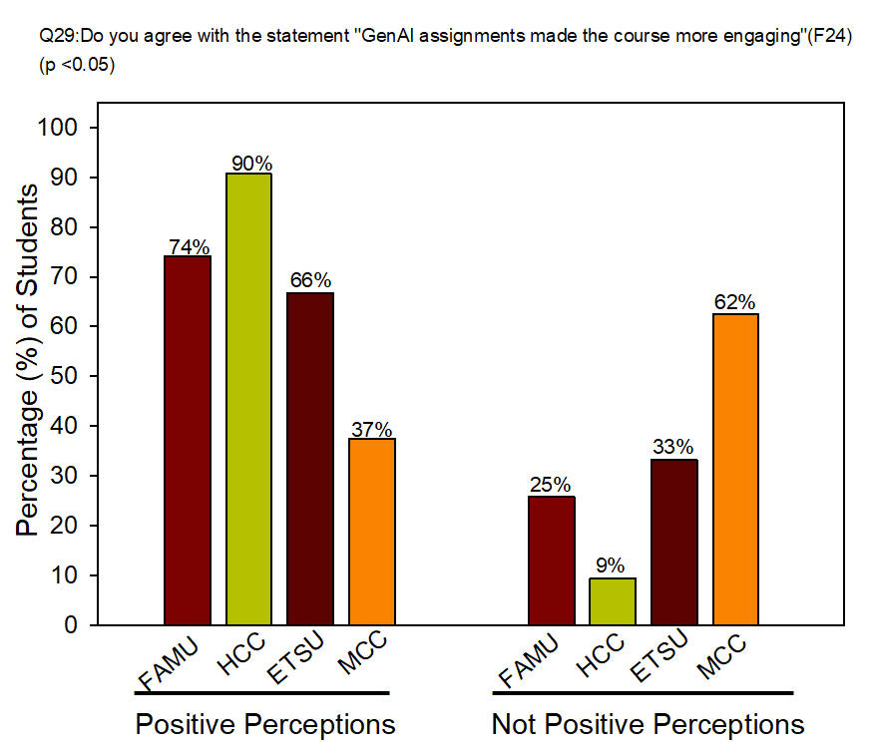
RESULTS
Figure 3. Significantly positive perceptions of GenAI.

Slide 12
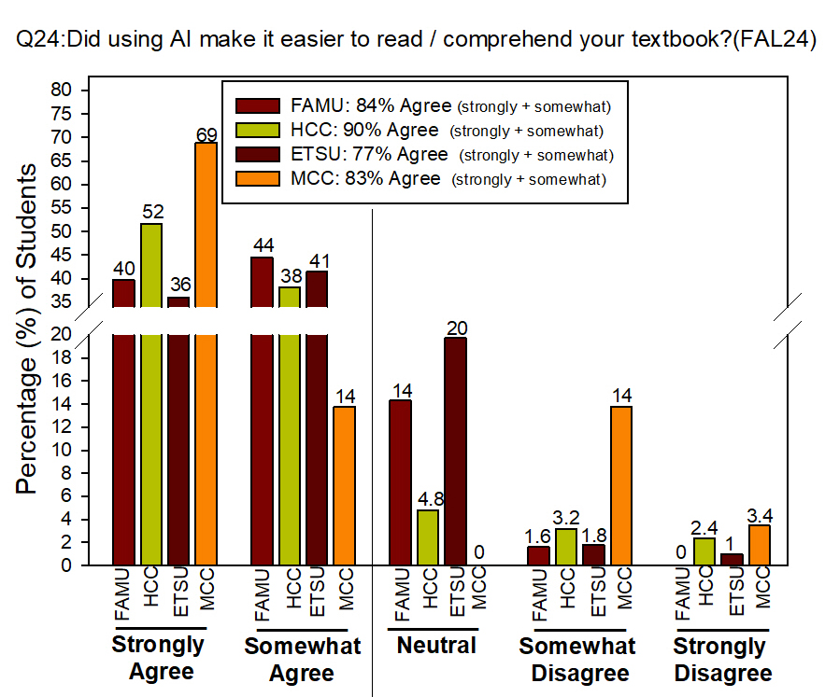
RESULTS
Figure 4. Impacts of GenAI on Reading & Comprehension.

Slide 13
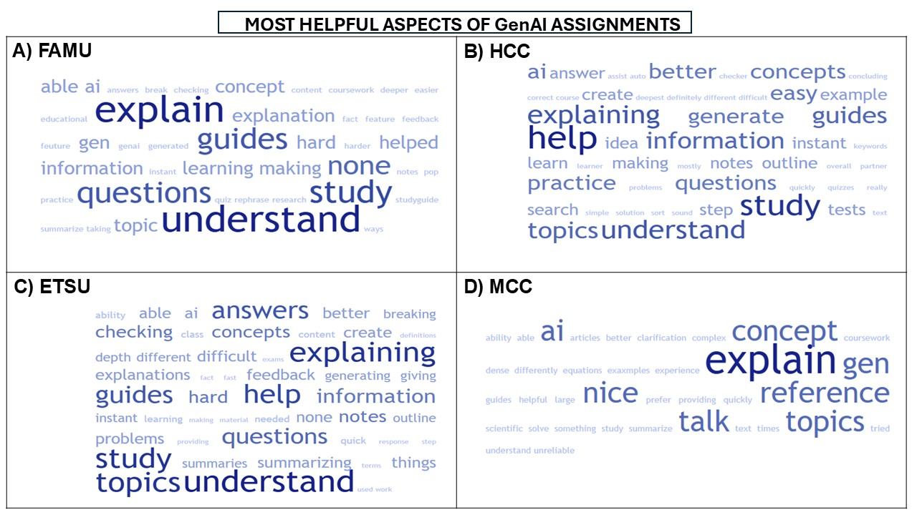
RESULTS
Figure 5. Top Themes Identified by four campuses.

Slide 14
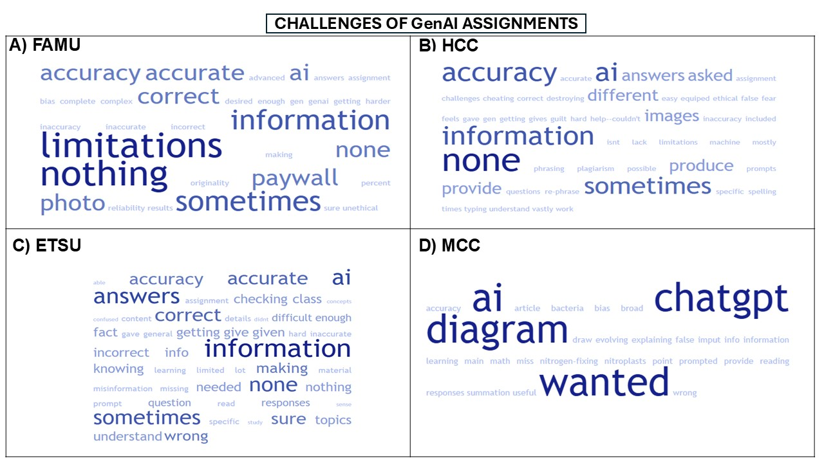
RESULTS
Figure 6. Top Challenges of GenAI by four campuses.

Slide 15
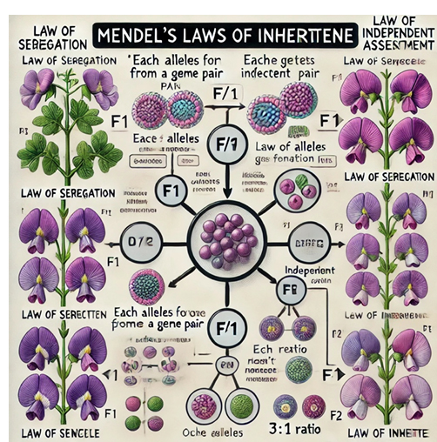
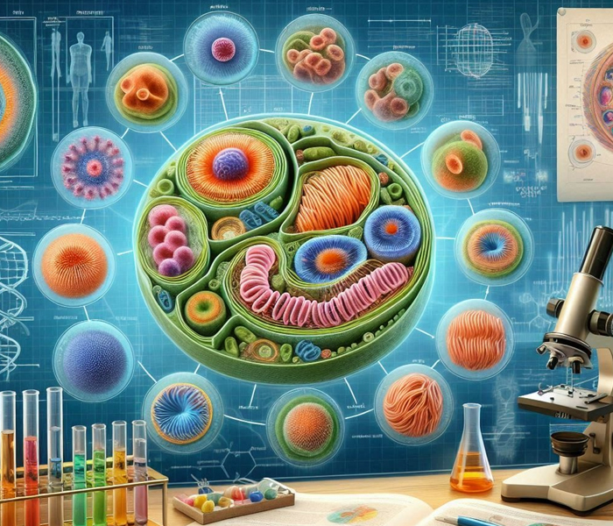
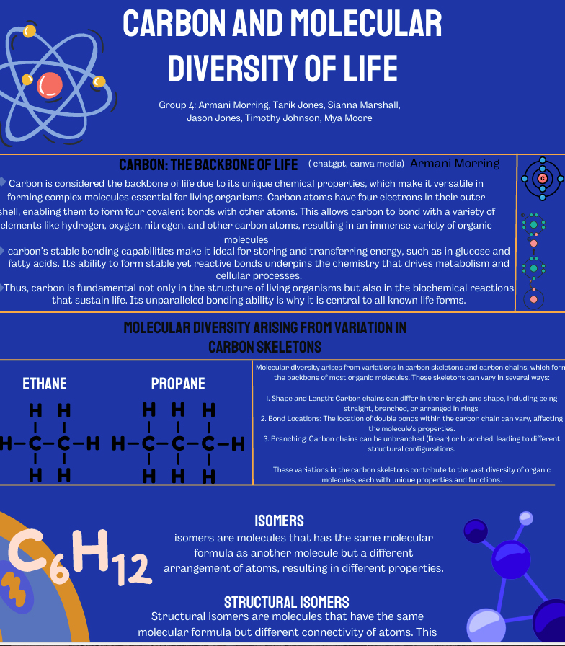
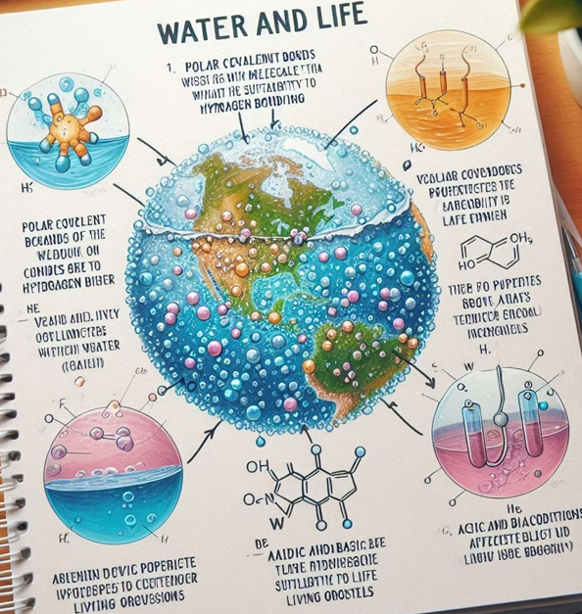
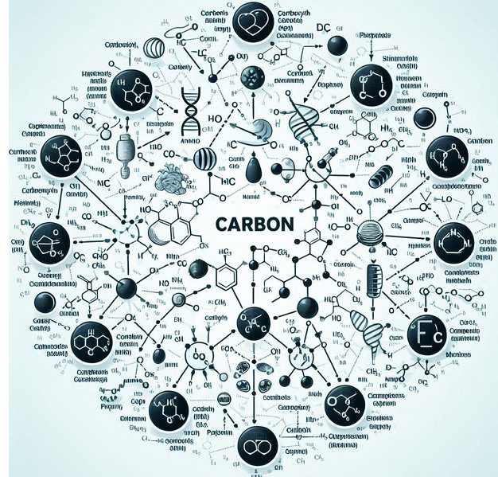
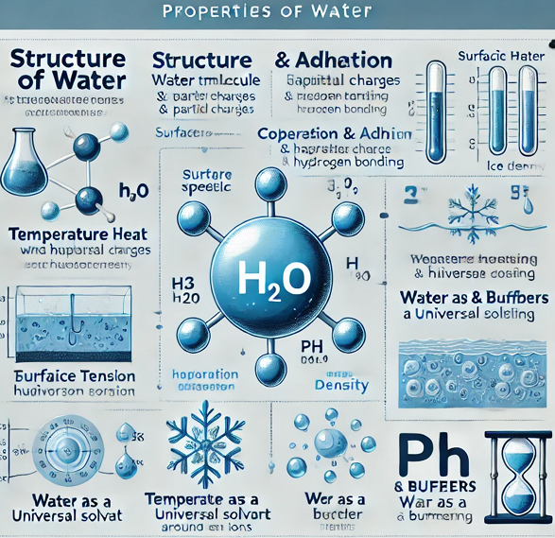
RESULTS (STUDY GUIDE)
Figure 7. GenAI Assignment #2: Creating Study Guide on a specific chapter

Slide 16
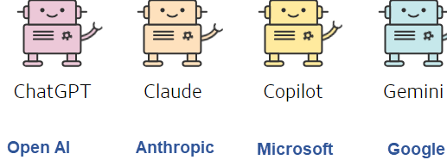
CONCLUSIONS / FUTURE AIMS
The first results suggest the positive effects of using GenAI supported assignments in Majors Biology courses.
A majority of the participants (avg: 67%) reported finding GenAI valuable to make the course more engaging.
The top themes for the most helpful aspects included “Explain” and “Understand”
Next steps: Spring semester data collection and investigate prompt types (Starter vs. Advanced)

Slide 17


ACKNOWLEDGEMENTS
Robin Heyden BLC/Pearson
Dr. Sarah Buxbaum for statistics
Dr. Jana Baldwin
All participants at 4 campuses
Dr. Gokhan Hacisalihoglu
Email: gokhan.h@famu.edu
Dr. Cerrone Foster
Email: fosterc@etsu.edu
Dr. Jennifer O’Neil
Email: jennifer.oneil@hccs.edu
Dr. Andy Baldwin
Email: baldwin@mesacc.edu
FAMU IRB Approved
Procol #021-24

