Slide 1

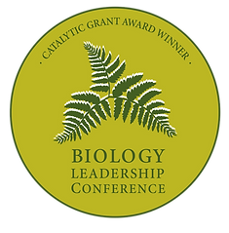

Using interventions to dislodge misconceptions and improve metacognition
[Getting them unstuck]
Katherine LaCommare · Natalie Mountjoy · Judy Nesmith · Kayleigh O’Keefe

Slide 2







Katherine LaCommare
Natalie Mountjoy
Judy Nesmith
Kayleigh O’Keeffe

Slide 3
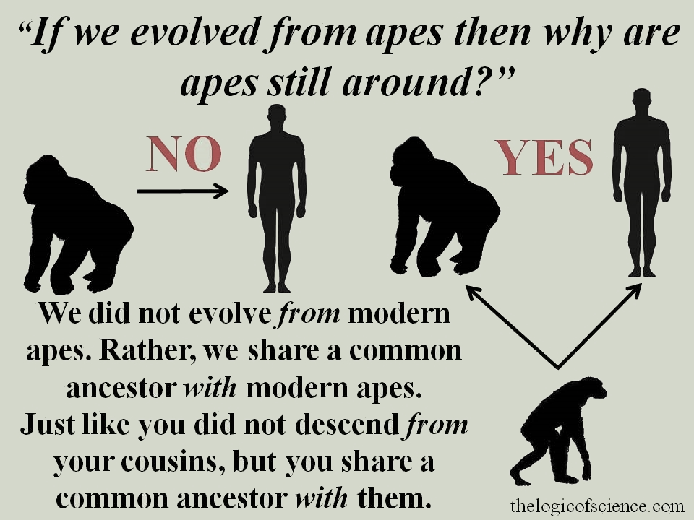
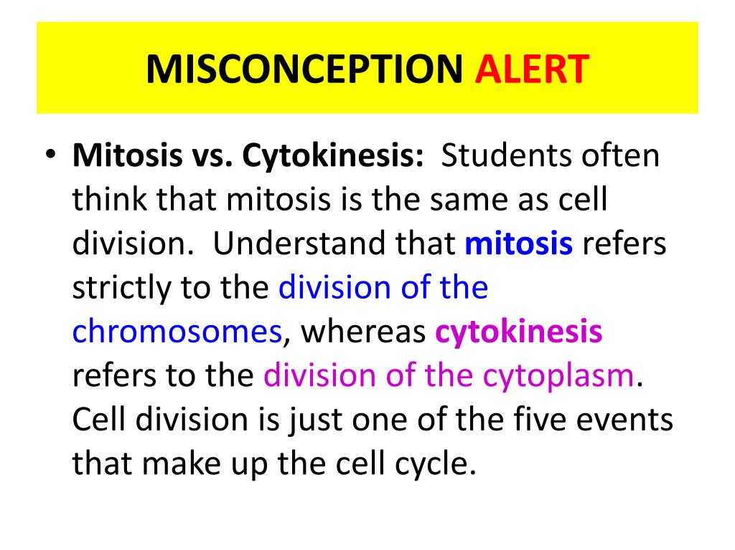
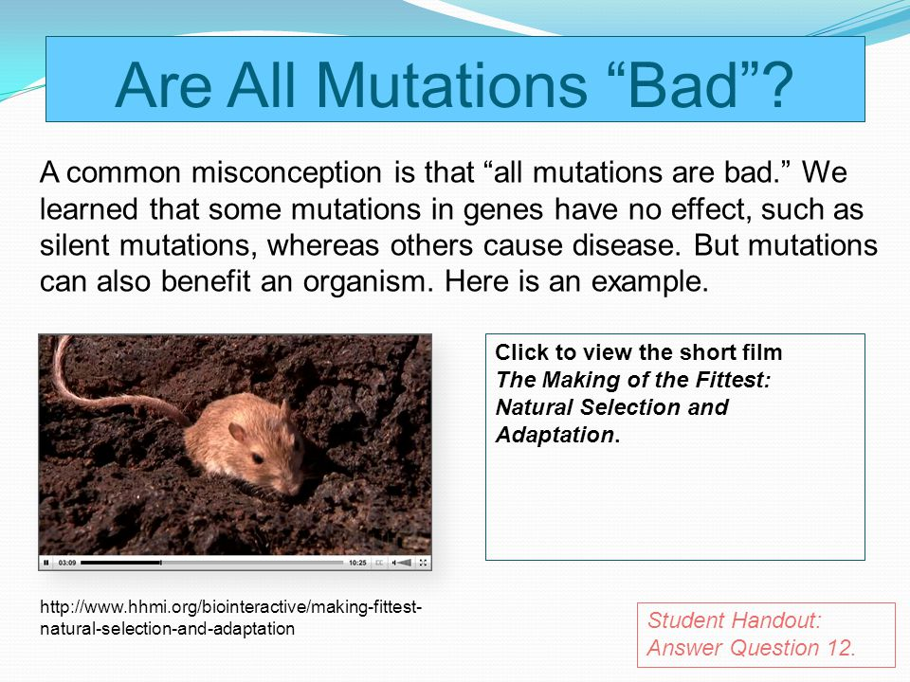
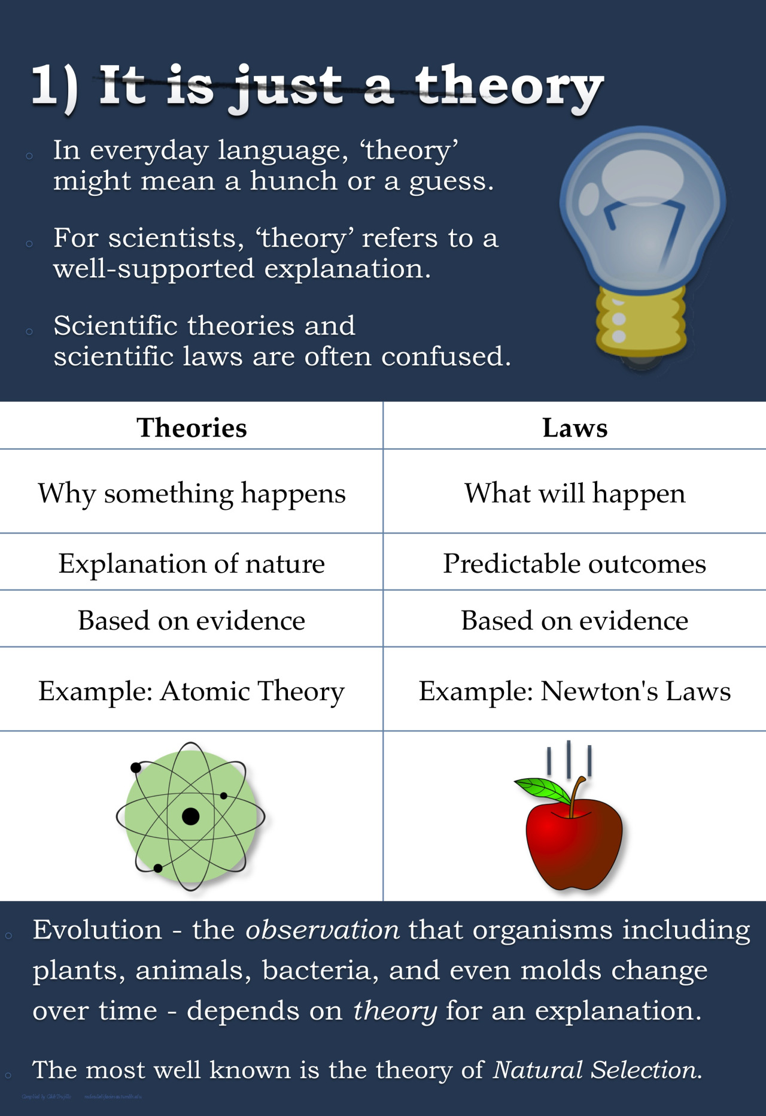
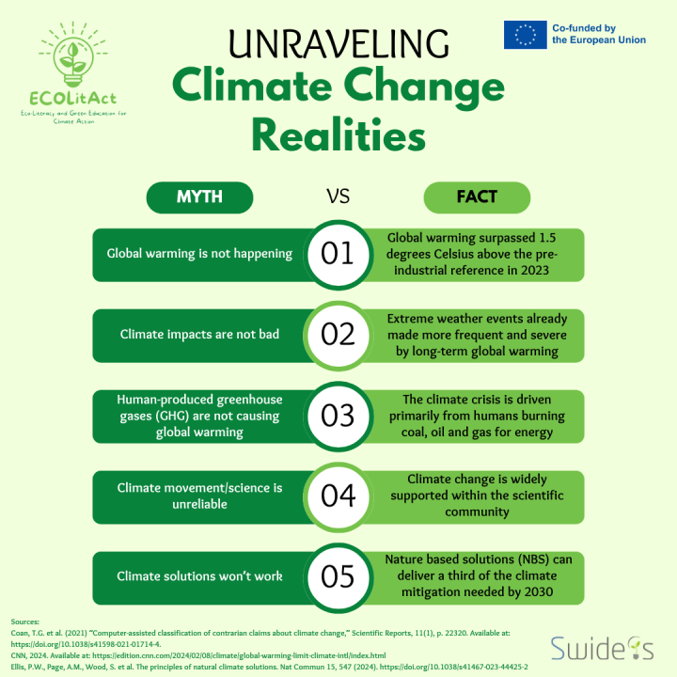
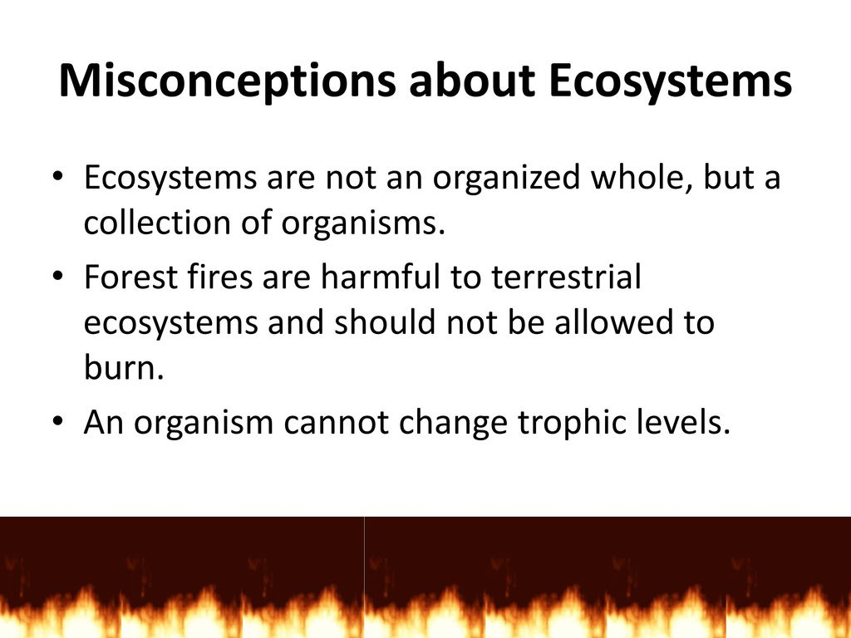
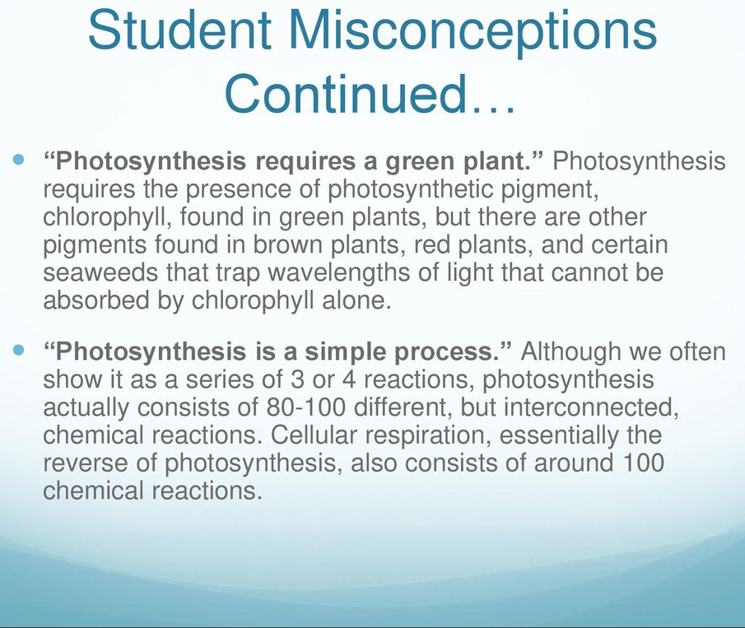

Slide 4



Science educators have identified three specific types of common misconceptions which predictably interfere with the learning process
Type | Description | Example
Teleological | Biology is goal-oriented and outcome-driven | Organisms adapt so they can survive
Essentialist | Biological units (cells, species, ecosystems, etc.) are uniform, static, and predictable | Without outside influences, ecological communities will remain stable indefinitely
Anthropocentric | Distort humans’ role in the biological world through over-attribution or personification | Humans have caused the most extinctions
(Coley & Tanner 2012)

Slide 5
Addressing misconceptions via metacognition
Constructivism: The process by which learners replace misconceptions with a more accurate understanding
Metacognition It is an ideal tool to address common misconceptions
Students are active participants
Study habits impact success
Improve student performance
Leveraged accurate information to dislodge misconceptions
(Bransford et al. 2018, Eyler 2018, Maskiewicz & Lineback 2013, McGuire et al., 2015, Nonis & Hudson 2010, Perkins 2006)

Slide 6


Hypotheses
Goals & Objectives
Address common misconceptions in
gateway biology courses using short modules, informed by Q-focus activities and based in metacognition
Misconceptions
Students will perform better on assessment questions in post vs. pre-intervention terms
Metacognition
Students will show more metacognitive growth in post vs. pre-intervention terms

Slide 7

Fall 2024
Spring 2025
Fall 2025
Across 3 Courses/ Across 3 Institutions
CONTROL: Project Development & Data Collection
Exam questions [Ctrl]
Misconception Analysis & Intervention Creation
TREATMENT: Data Collection & Hypothesis Testing
Exam questions [Tx]
Q-Focus/QFT
Pre-intervention performance
Quantitative
Metacognition Survey [Ctrl]
Beginning of term
Quantitative
Post-intervention performance
Beginning of term
Metacognition Survey [Tx]
Collate & analyze data
Analyze Q-focus
H₁: Compare pre vs. post exam performance data
H₂: Compare pre vs. post metacognition
Metacognition Survey
Targeted
Metacognitive
Use those data to create intervention for each of the 5 topics >>>
Exam questions
Same 5 topics
End of term
End of term
4 misconceptions a priori
Qualitative
Notes:
Talk about Slide 7 here. Our goals and objectives – Say out load and this is our plant.

Slide 8
Misconception Assessment Question Examples
[developed a priori through years of experience teaching introductory biology]
Climate Change
Phylogenies
Hardy-Weinberg
A white, short tailed cat is crossed with a brown, long tailed cat resulting in offspring that include white, long tailed cats. Which of the following answers most likely accounts for this? Choose only one answer.
Consider a small population of beetles where two alleles, A (dominant) and a (recessive), are present. Which of the following shifts in allele frequencies could be explained by genetic drift?
In the above tree, assume that the ancestor had a long tail, ear flaps, external testes, and fixed claws. Assuming that all evolutionary changes in these traits are shown, what traits does a sea lion have?
This past winter was an especially cold and snowy one for parts of the United States, Europe and elsewhere. Surely such cold weather flies in the face of global warming? Select the appropriate responses.
Drift vs. Selection

Slide 9
Question Analysis: Descriptive Data [CTRL F25]
1 Course
N = 348
3 Courses
N = 927
3 Courses
N = 720
N = 1000
3 Courses
 | N Questions | N Students | N Responses
Mountjoy
Climate Change | 4 | 87 | 348
Drift vs. Selection | 4 | 91 | 364
Hardy-Weinberg Equilibrium | 4 | 91 & 100 | 291
Phylogenies | 4 | 91 & 100 | 482
Nesmith
Climate Change | 0 | 0 | 0
Drift vs. Selection | 3 | 52 & 53 | 158
Hardy-Weinberg Equilibrium | 5 | 53 | 159
Phylogenies | 3 | 49 & 50 | 248
O’Keefe
Climate Change | 0 | 0 | 0
Drift vs. Selection | 3 | 135 | 405
Hardy-Weinberg Equilibrium | 2 | 135 | 270
Phylogenies | 3 | 135 | 270
Total N = 2,995

Slide 10




Question Analysis: Difficulty [CTRL F25]
MODERATE
HARD

Slide 11
Question Analysis: Difficulty* [CTRL F25]
MODERATE
HARD
*weighted by N

Slide 12
Question Analysis: Discrimination* [CTRL F25]
FAIR
POOR
*weighted by N

Slide 13
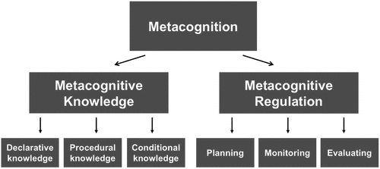
Metacognitive Awareness Inventory (MAI)
52 items
Knowledge of cognition (17 items)
Regulation of cognition (35 items)
True or False
Yes or No Responses
IRB-Approval at each institution
Consent
Anonymous & voluntary
Given in-class
Framework
Schraw & Dennison 1994, Schraw & Moshman 1995

Slide 14
Metacognitive Awareness Inventory [CTRL F25]
*
*retrospective

Slide 15
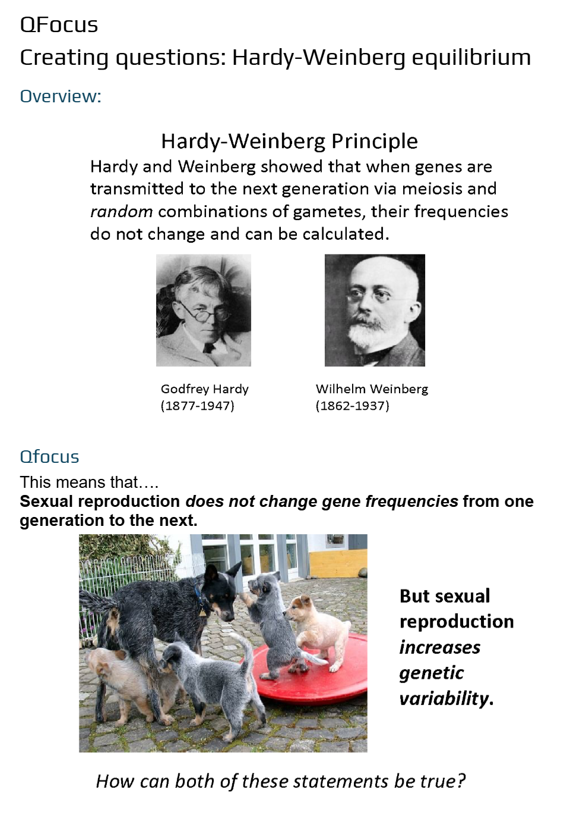
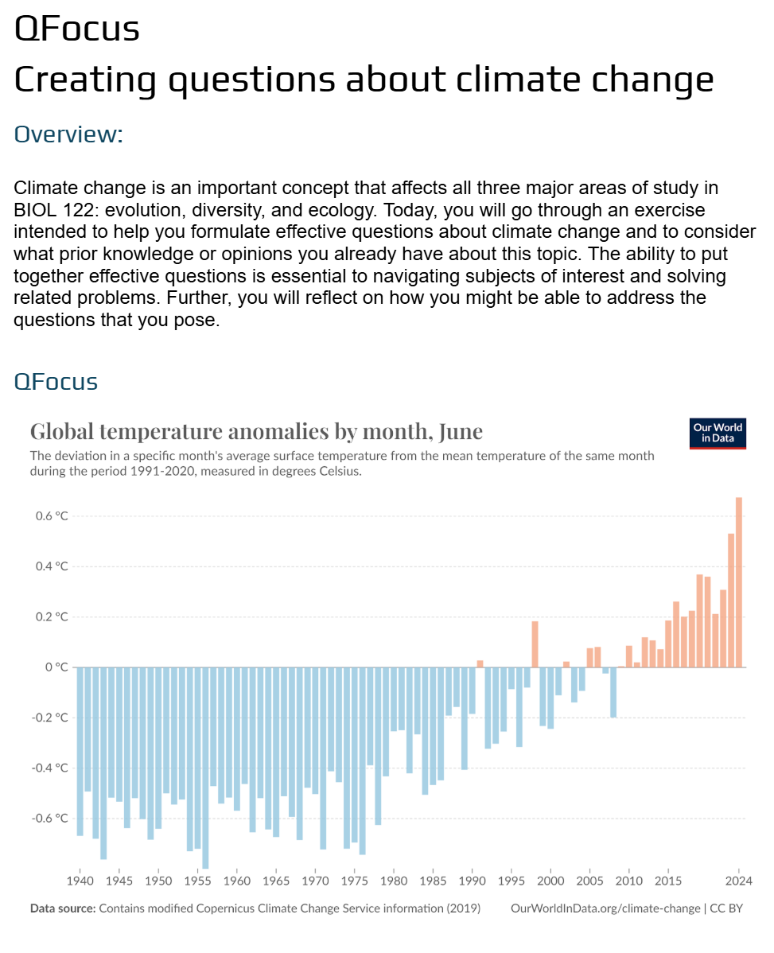
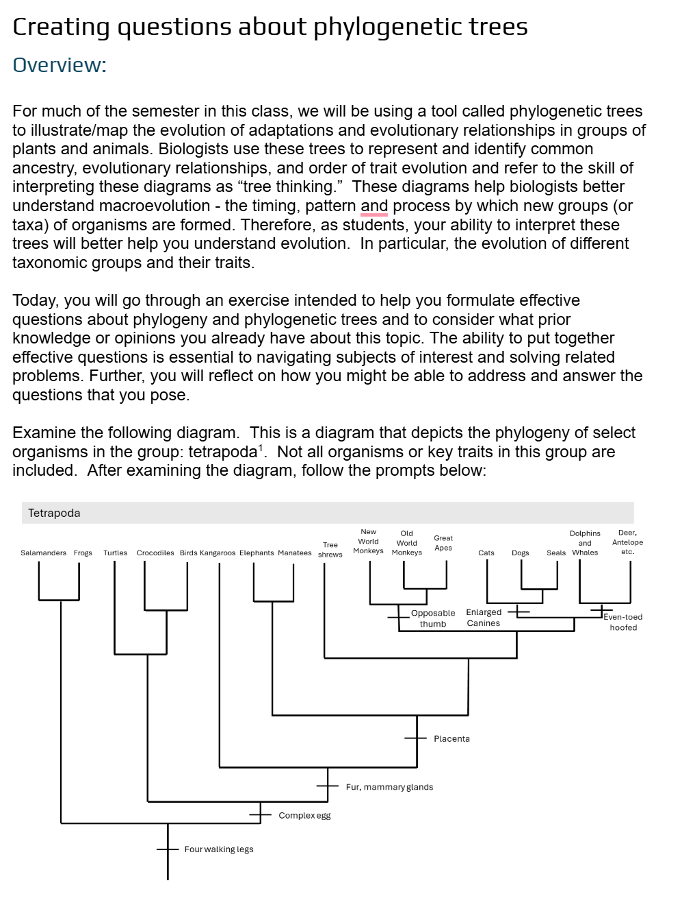
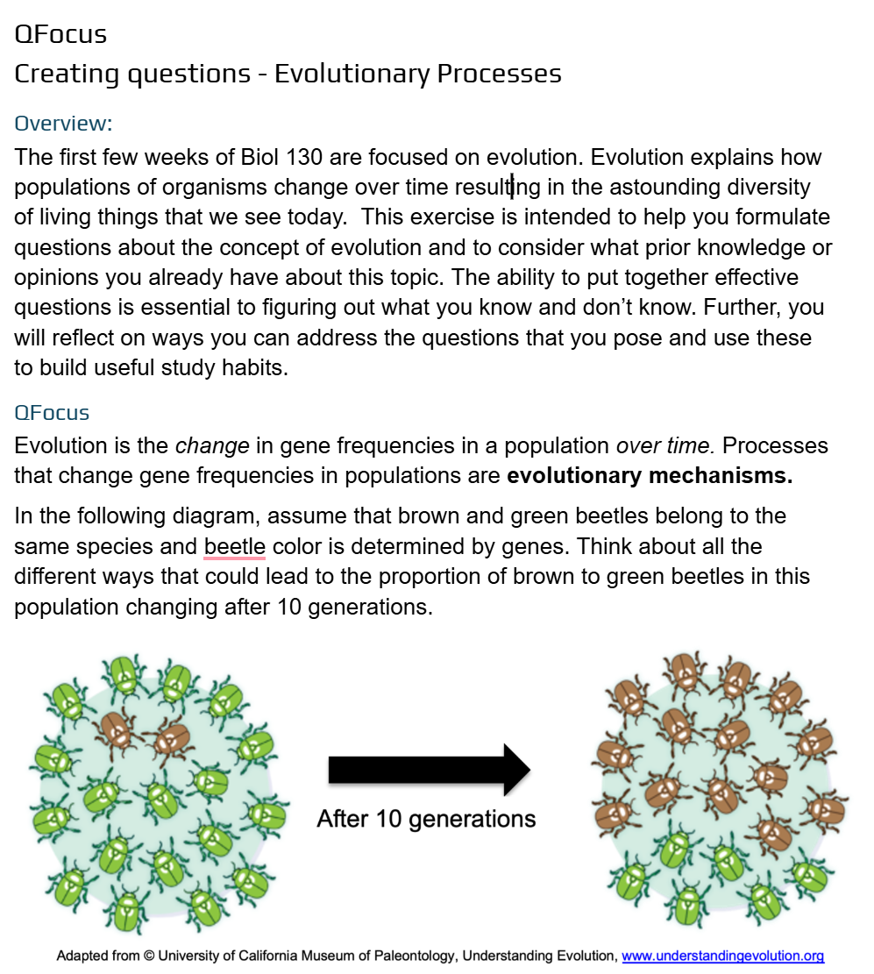

Slide 16

Fall 2024
Spring 2025
Fall 2025
Across 3 Courses/ Across 3 Institutions
CONTROL: Project Development & Data Collection
Exam questions [Ctrl]
Misconception Analysis & Intervention Creation
TREATMENT: Data Collection & Hypothesis Testing
Exam questions [Tx]
Q-Focus/QFT
Pre-intervention performance
Quantitative
Metacognition Survey [Ctrl]
Beginning of term
Quantitative
Post-intervention performance
Beginning of term
Metacognition Survey [Tx]
Collate & analyze data
Analyze Q-focus
H₁: Compare pre vs. post exam performance data
H₂: Compare pre vs. post metacognition
Metacognition Survey
Targeted
Metacognitive
Use those data to create intervention for each of the 5 topics >>>
Exam questions
Same 5 topics
End of term
End of term
4 misconceptions a priori
Qualitative

Slide 17

Moving Ahead
May include more questions asked in each topic
Complete Q-Focus Analysis
Individual item analysis on multiple select questions
Develop interventions for F25
Compare pre vs. post intervention
Question Difficulty
Metacognitive Growth
Individually and across all three courses
Did the interventions make a difference?
Normalize question difficulty by exam difficulty
Review Qs with > .06 difficulty scores
Conduct interventions & use same exam questions

Slide 18
Special Thanks to the BLC
Catalytic Grant Program
Biology Leadership Community participants are invited to apply for one of two $10,000 catalytic grants. The catalytic grants will support inter-college collaborations formed to devise innovations in general biology education. Each grant will fund one, highly-focused idea that might not be funded through departmental money or through other granting bodies. A catalytic grant could also form the basis for a subsequent, larger grant proposal to an agency such as NSF or HHMI. Catalytic grant funds must be used to support the participants’ collaboration.

Slide 19
References
Bransford, John D., Brown Ann L., and Cocking Rodney R. (2000). How people learn: Brain, mind, experience, and school. Washington, D.C.: National Academy Press.
Chen, C., Sonnert, G., Sadler, P. M., & Sunbury, S. (2020). The impact of high school life science teachers’ subject matter knowledge and knowledge of student misconceptions on students’ learning. CBE—Life Sciences Education, 19(1).
Coley JD, Solomon GEA, Shafto P (2002). Ed. P KahnS Kellert, The development of folkbiology: a cognitive science perspective on children’s understanding of the biological world In: In: Children and Nature: Psychological, Sociocultural and Evolutionary Investigations, Cambridge, MA: MIT Press, 65-91.
Coley, J. D., & Tanner, K. (2015). Relations between intuitive biological thinking and biological misconceptions in biology majors and nonmajors. CBE—Life Sciences Education, 14(1).
De Boer, H., Donker, A. S., Kostons, D. D., & Van der Werf, G. P. (2018). Long-term effects of metacognitive strategy instruction on student academic performance: A meta-analysis. Educational Research Review, 24, 98-115.
Dignath, C., & Veenman, M. V. J. (2021). The role of direct strategy instruction and indirect activation of self-regulated learning—evidence from classroom observation studies. Educational Psychology Review, 33(2), 489–533.
Ewell SN, Driessen EP, Grogan W, Johnston Q, Ferdous S, Mehari Y, Peart A, Seibenhener M, Ballen CJ. (2023). A Comparison of Study Behaviors and Metacognitive Evaluation Used by Biology Students. CBE Life Sci Educ. 22(4).
Gelman, S and Rhodes, M (2012) “Two-Thousand Years of Stasis”: How Psychological Essentialism
Impedes Evolutionary Understanding. In Evolution Challenges, Rosengren et a. Eds. Oxford University Press, 2012.
Google, A. N., Gardner, G. & Grinath, A. S. (2021) Undergraduate students’ approaches to learning biology: A systematic review of the literature. Studies in Science Education, 59(1), 25-66.
Lang, J. M. (2016). Small teaching: everyday lessons from the science of learning. First edition. San Francisco, CA, Jossey-Bass.
Maskiewicz AC, Lineback JE. (2013). Misconceptions are "so yesterday!". CBE Life Sci Educ. 2013 Fall;12(3):352-6.
McGuire, S., McGuire, S. Y., & Angelo, T. (2015). Teach students how to learn: Strategies you can incorporate into any course to improve student metacognition, study skills, and motivation. Routledge.
Nonis, S. A., & Hudson, G. I. (2010). Performance of College Students: Impact of Study Time and Study Habits. Journal of Education for Business, 85(4), 229–238. https://doi.org/10.1080/08832320903449550
Perkins, David. “Constructivism and Troublesome Knowledge.” Overcoming Barriers to Student Understanding: Threshold Concepts and Troublesome Knowledge, 1st ed., Routledge, London, UK, 2006, pp. 33–47.
Pintrich, Paul R. (2002). The Role of metacognitive knowledge in learning, teaching, and assessing. Theory into Practice, 41(4). 219-225.
Schraw, G., & Dennison, R. S. (1994). Assessing metacognitive awareness. Contemporary Educational Psychology, 19(4), 460–475. https://doi.org/10.1006/ceps.1994.1033
Vemu, S., Denaro, K., Sato, B. K., Fisher, M. R., and Williams, A. E. (2022). Moving the needle: evidence of an effective study strategy intervention in a community college biology course. CBE Life Sci. Educ. 21-24.
Wandersee JH, Mintzes JJ, Novak JD (1994). Ed. D Gabel, Research on alternative conceptions in science In: In: Handbook of Research on Science Teaching and Learning, New York: Macmillan, 177-210.
Zohar, A., Weinberger, Y., & Tamir, P. (1994). The effect of the biology critical thinking project on the development of critical thinking. Journal of Research in Science Teaching, 31(2), 183-196.

