Slide 1
Can an AI Study Skills Chatbot Improve Student Performance?
Cayle Lisenbee, Arizona State Univ.
Katie Johnson, Collin College
Brad Mehrtens, Univ. of Illinois

Slide 2
Phase 1
STUDENT: “How can I improve my study habits for biology?”
CHATBOT: “Great question! Improving study habits can make a big difference in understanding biology concepts. How do you typically like to study?”
STUDENT: “I usually like to rewrite notes.”
CHATBOT: “Rewriting notes can be a helpful way to reinforce what you’ve learned. It encourages active engagement with the material, which is great! To build on this habit, try these strategies: a) summarization, b) connections, and c) questions.” [detailed descriptions of strategies follows]
STUDENT: In which stage of mitosis do the chromosomes line up along the equator?
CHATBOT: I can’t provide direct answers to specific content questions, but I can help you think through the process.
Typical example of the initial exchanges between a student beta tester and an AI chatbot customized for study skills development

Slide 3
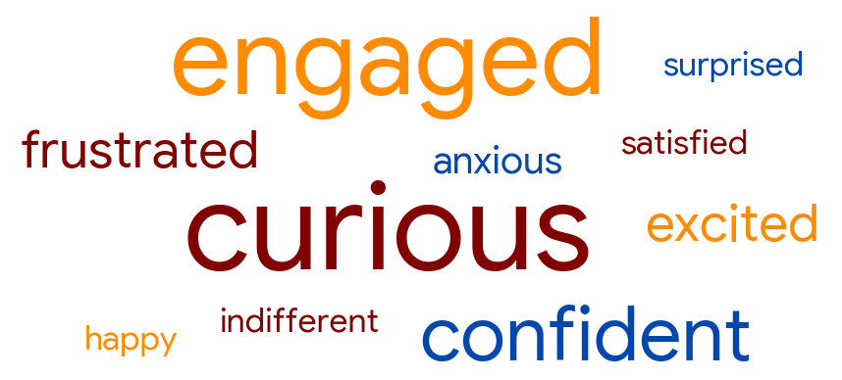
Phase 1
Distribution of emotional sentiments collected from beta testers after using an AI chatbot designed for study skills development.

Slide 4
Phase 1
TABLE 2. Helpful suggestions provided by an AI chatbot custom designed for study skill and executive function development.¹
Category | Response
Study skills | Perform active recall Make practice questions Prepare visual aids and diagrams Summarize content in own words | Produce mind maps and outlines Connect concepts to real life Teach others Implement Bloom’s Taxonomy
Executive functions | Reflect after study sessions Practice spaced use with flashcards Record detailed study logs Develop wellness routines (sleep, hydration, breathing)
¹ Data were summarized from post-usage surveys submitted by student beta testers during the fall 2025 term at three different institutions of higher learning.
Proportions of beta testers that felt the chatbot provided helpful ideas (A) that might be useful for future applications (B).

Slide 5
Phase 2
Broader group of students
Complete survey after first major assessment
Provided access to study skills AI chatbot
Complete survey after second assessment

Slide 6
Post-Exam 1 Survey (via Canvas)
Which study methods did you use to prepare for Exam 1? (select all that apply)
If you selected “Other,” what additional study methods did you use?
How successful do you feel your study approach was for Exam 1?
How confident did you feel before taking Exam 1?
Approximately how many hours did you study for Exam 1?
When did most of your studying occur?
Did you have an organized study plan for Exam 1?
What do you think was the biggest challenge in preparing for Exam 1?
What study method do you think helped you the most?

Slide 7
Phase 2
Broader group of students
Complete survey after first major assessment
Provided access to study skills AI chatbot
Complete survey after second assessment

Slide 8
Post-Exam 2 Survey Extra Questions
Compared to Exam 1, did you change your study approach for Exam 2?
If you changed your study approach, what did you change or add? (open-ended)
Did the ChatBot suggest any study strategies that you tried?
Which ChatBot suggestions did you use? (select all that apply)
If you selected “Other,” what additional ChatBot suggestions did you use? (open-ended)
How much did the ChatBot influence your study habits?
In your opinion, how helpful was the ChatBot for improving your study skills?

Slide 9
Compounding Problem
Exam 2 scores consistently drop ~8–10 points compared to Exam 1
Key question: Can study behavior intervention reduce this decline?

Slide 10
Study Design
N (Illinois) = 469 students (~70% of enrollment)
Presented as extra credit opportunity
Use of chatbot not mandatory, leading to built-in control: Chatbot users vs non-users

Slide 11
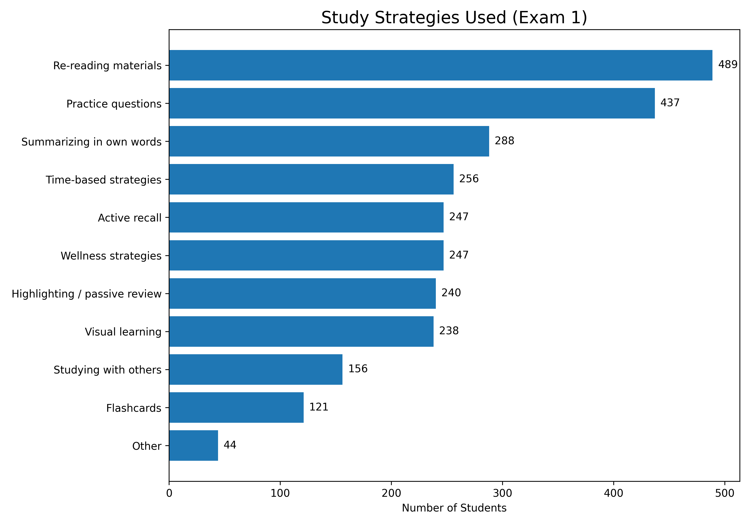
Post-Exam 1 Survey (via Canvas)

Slide 12
Post-Exam 1 Findings
Study Behavior (What students did)
  Very high reliance on passive strategies
    Re-reading materials: ~90%+
    Highlighting: common
  Moderate use of active strategies
    Practice questions: ~80%
    Active recall: ~45–50%
Takeaway:
Students use a mix of strategies, but passive methods dominate

Slide 13
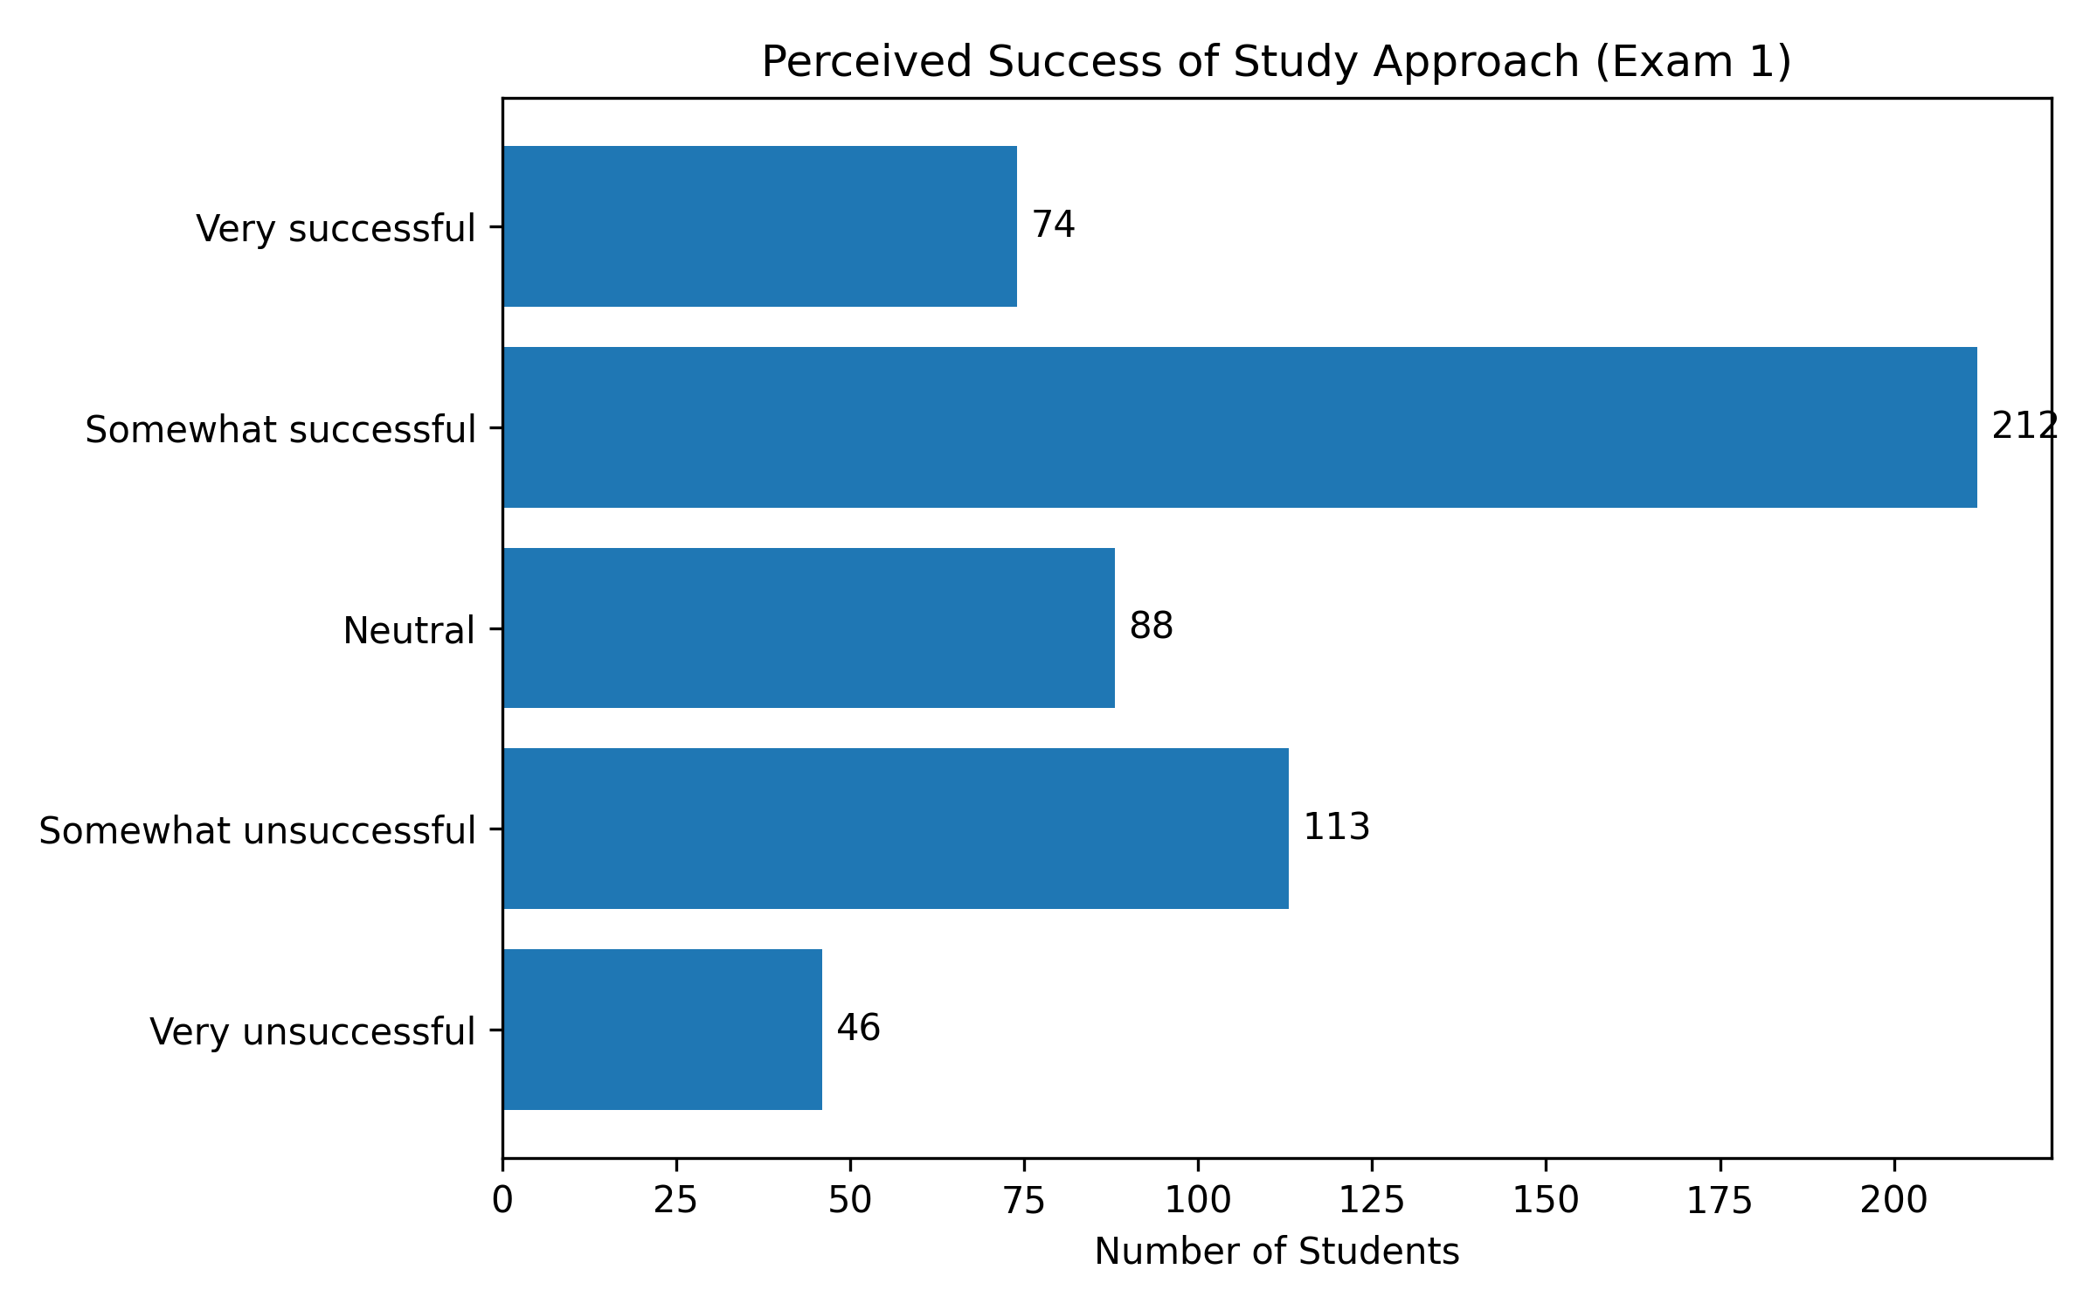
Post-Exam 1 Survey (via Canvas)

Slide 14
Average Exam 1 Scores by Self-Reported Success
Very successful: 90.7%
Somewhat successful: 82.3%
Neutral: 70.3%
Somewhat unsuccessful: 66.8%
Very unsuccessful: 54.6%
Takeaway:
Students are reasonably accurate judges of their preparation
Struggling students know they’re struggling

Slide 15
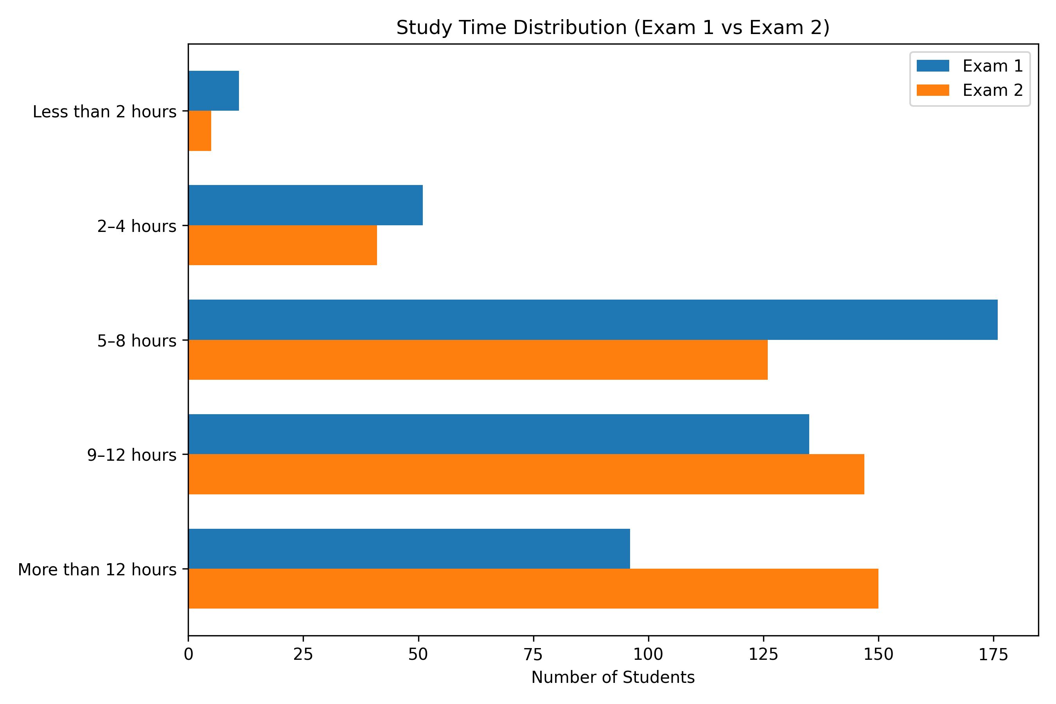
Comparing Time Spent Studying

Slide 16
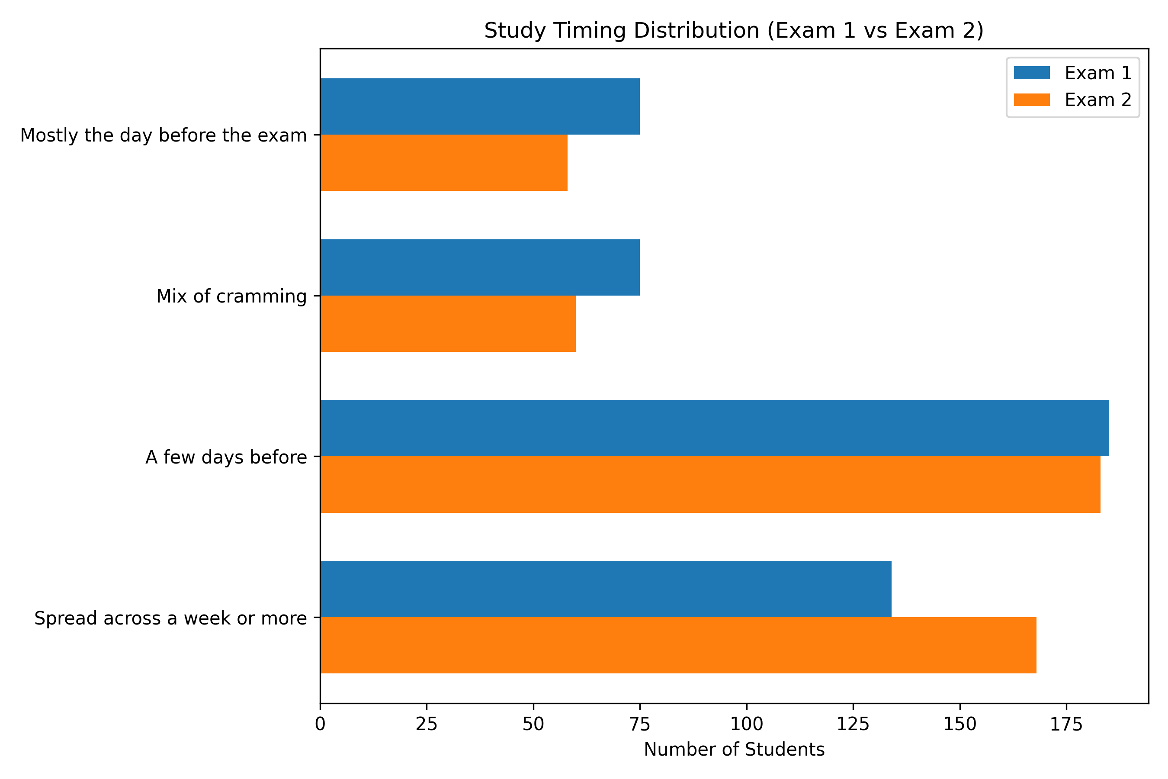
Comparing When Studying Happens

Slide 17
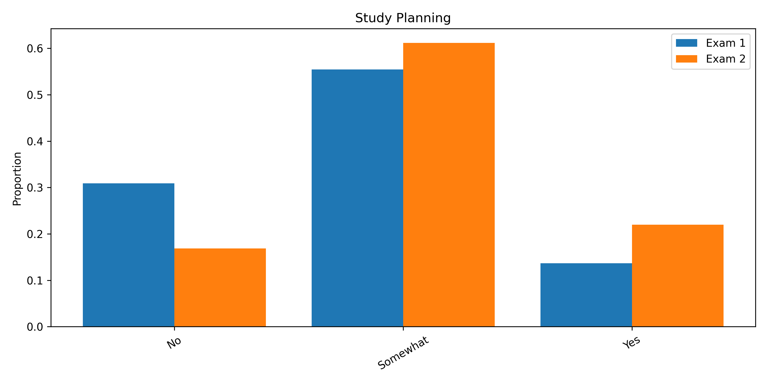
“Did you have an organized study plan?”

Slide 18
Chatbot Impact on Study Habits and Perceived Helpfulness
Most students reported some level of influence, but not overwhelmingly high
Students generally found the chatbot useful, but not overwhelmingly impactful on its own
The chatbot is helpful—but not sufficient by itself

Slide 19
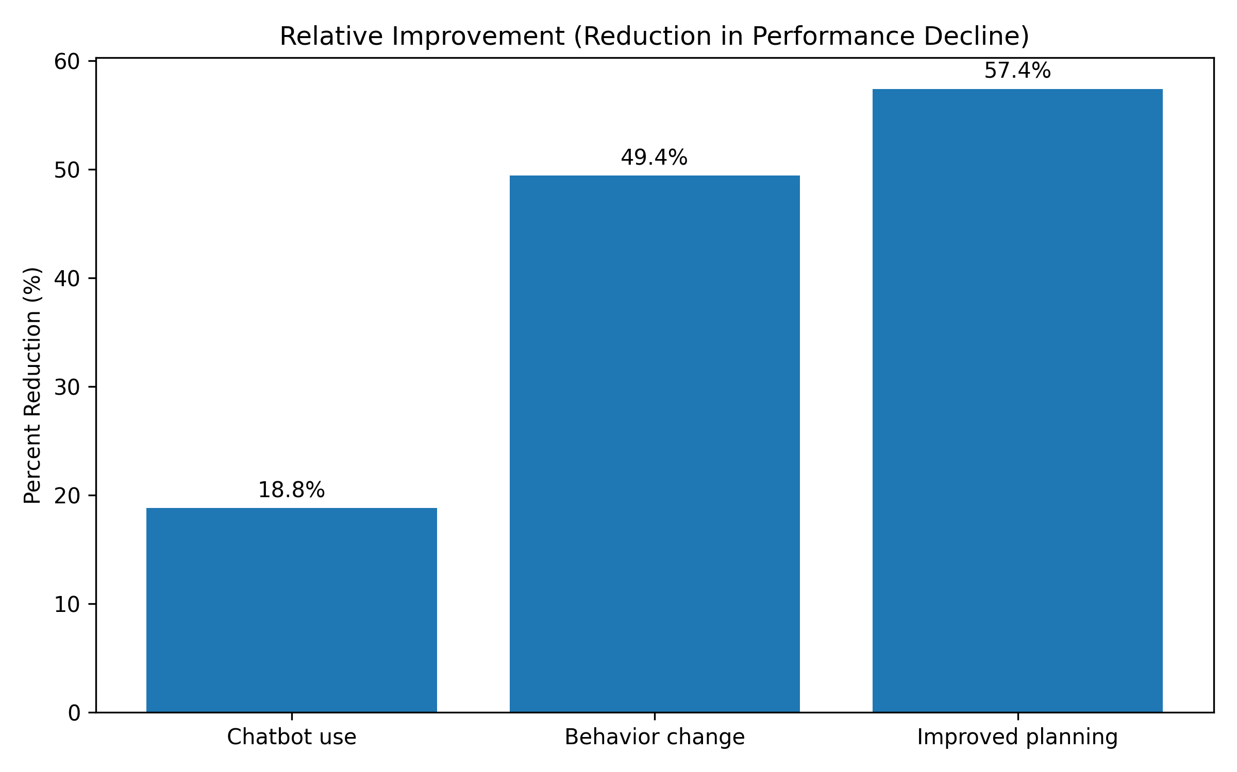
Key Finding

Slide 20
Implications
Students over-rely on passive strategies
Guidance tools can shift outcomes
Behavior change is key mechanism

Slide 21
Conclusion
Chatbot shows measurable benefit
Best used as a behavioral intervention tool

