Slide 1

Undergraduate Research at a 2-year College
Katie Johnson
Collin College

Slide 2

Research at a 2-year college
Limited options for undergraduate research and hands-on lab experience
Engagement in traditional biology lab courses
Intro to Biology I labs have transitioned to project-based inquiry format

Slide 3

Center for Advanced Studies in Math and Natural Science (CAMSNS)
Targeted towards students majoring in STEM fields
3.0 GPA or higher
Small group of 2-4 students that work with a faculty advisor
Generally incorporated into existing faculty research projects
Limited exposure to the process of science, experimental design, proposals
Semester based projects
Limited time frame
Poster creation and presentations
Local presentations at the college: Cultivating Scholars and STEM Symposium
30 years in existence

Slide 4
Next Steps: CASMNS and Undergraduate Research at Collin College
CASMNS Fellowship Program
Expansion
Expand to a 1-year program
Promote inquiry, background research, experimental design, supplies/ordering, and
Writing a grant proposal
Awards for project funding: $500-$1000 per project
Covers expenses for supplies and equipment to complete the project

Slide 5
Experience the Process of Science
Identify a research question
Literature reviews and background research
Create a testable hypothesis
Experimental Design
Identify and create a budget for supplies
Write a grant proposal

Slide 6

Additional Benefits
Increase faculty participation
Increase opportunities for students
Increase buy in and comprehension of the project
Enhance the research experience
Enhance posters and presentations
Expand the opportunities to present outside the college

Slide 7
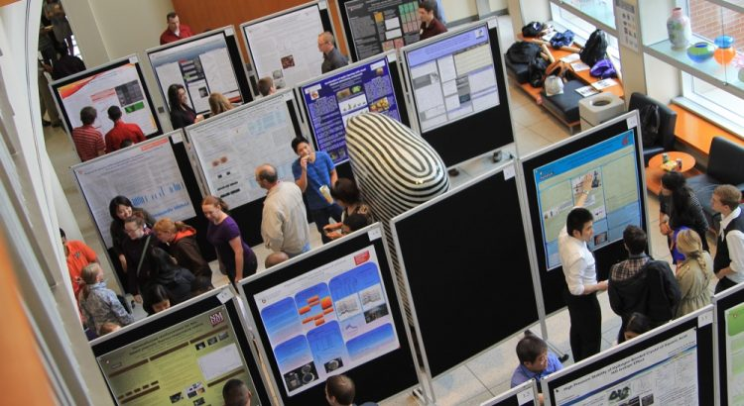
Suggestions?

