Slide 1


One Size Does Not Fit All: Assessment of Multiple Reading Strategies First Year Biology Students Use to Read Primary Scientific Literature

Slide 2
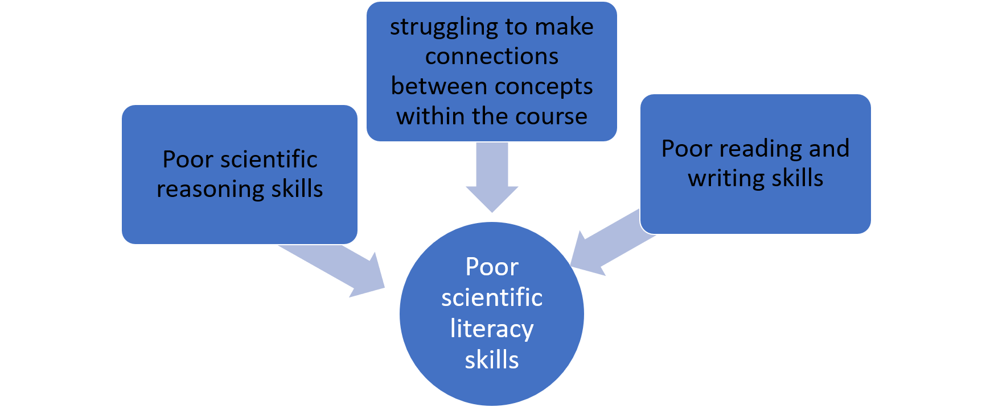
Primary Scientific Literature (PSL) is a valuable and useful tool for STEM.
Current assessments measuring the success of PSL-based interventions focus mainly on specific scientific content and/or the specific scientific skills students learn.

Slide 3
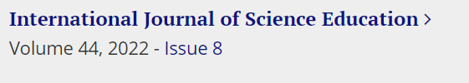

Question 1
Can we develop an assessment tool that measures student motivations for reading PSL and expert-like strategies when learning to read PSL?

Slide 4
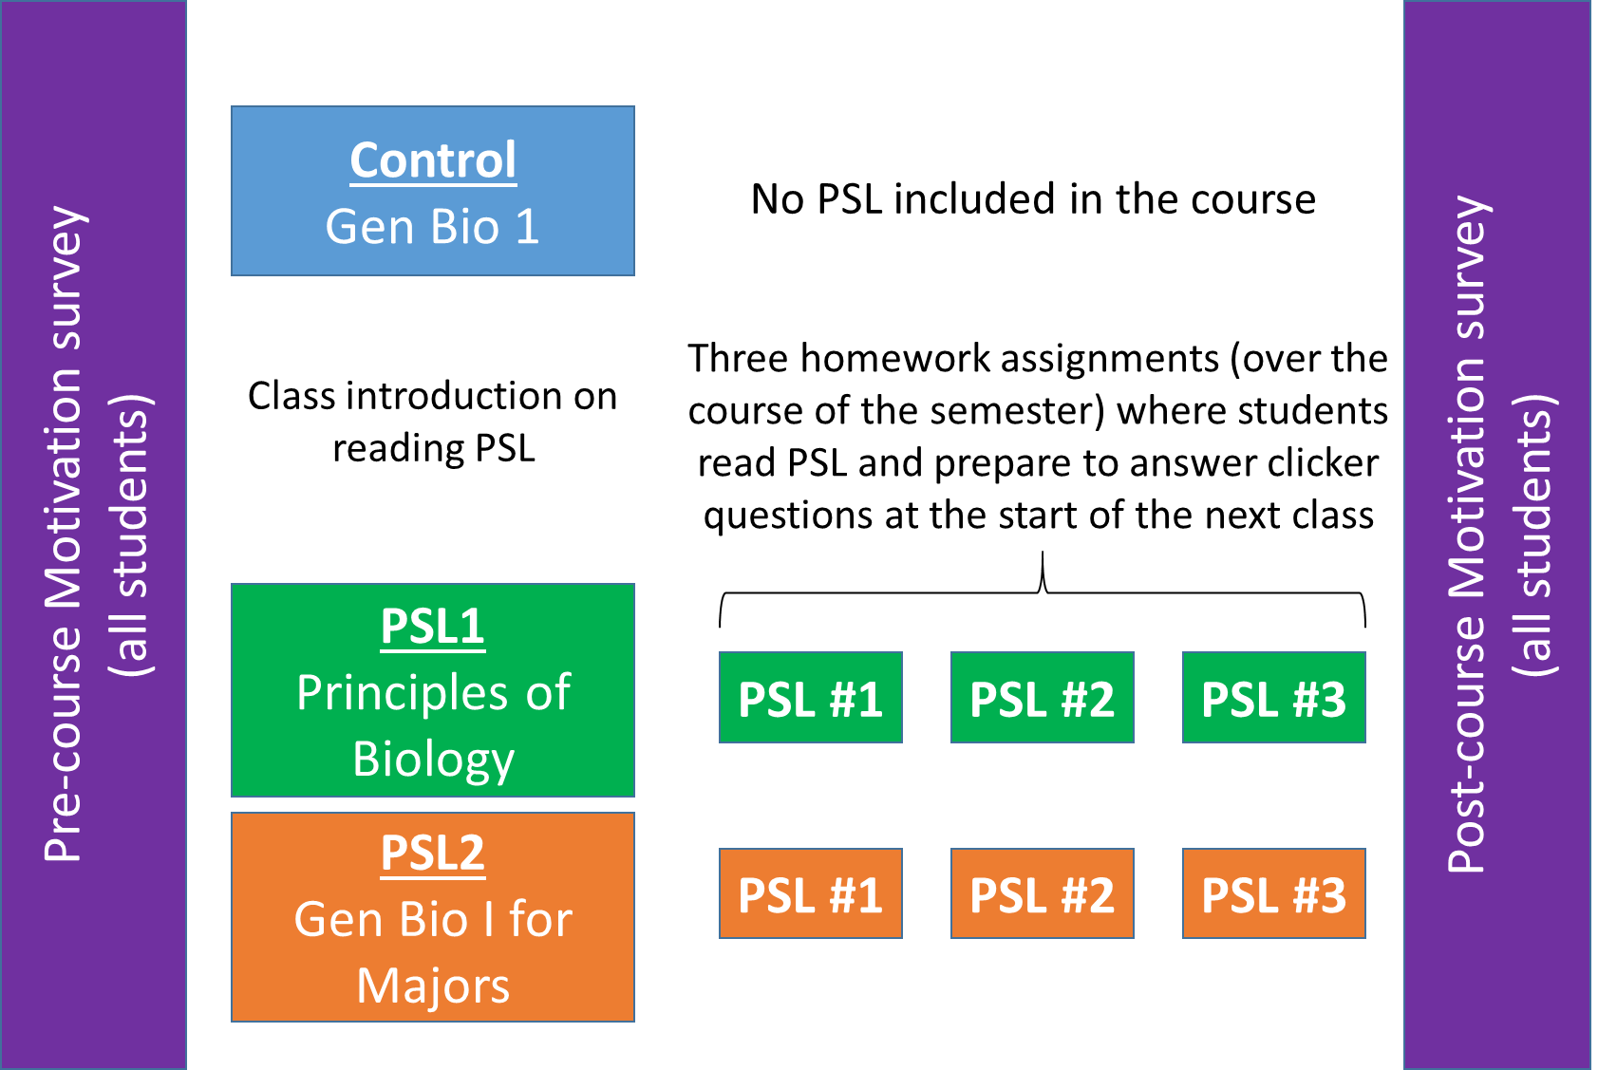
Methods

Slide 5
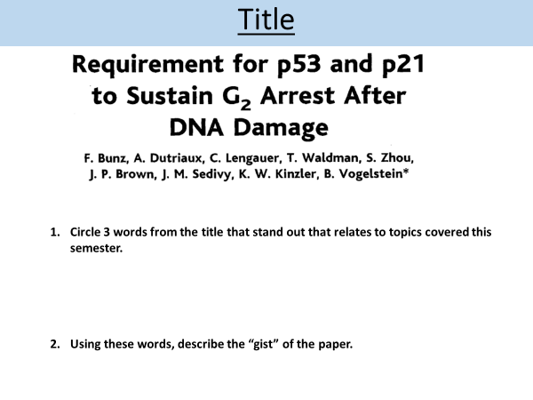
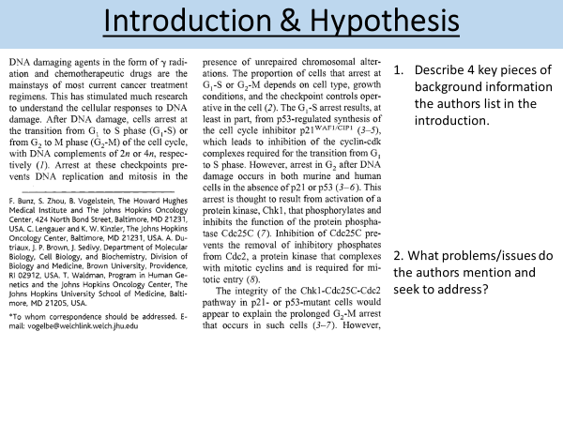
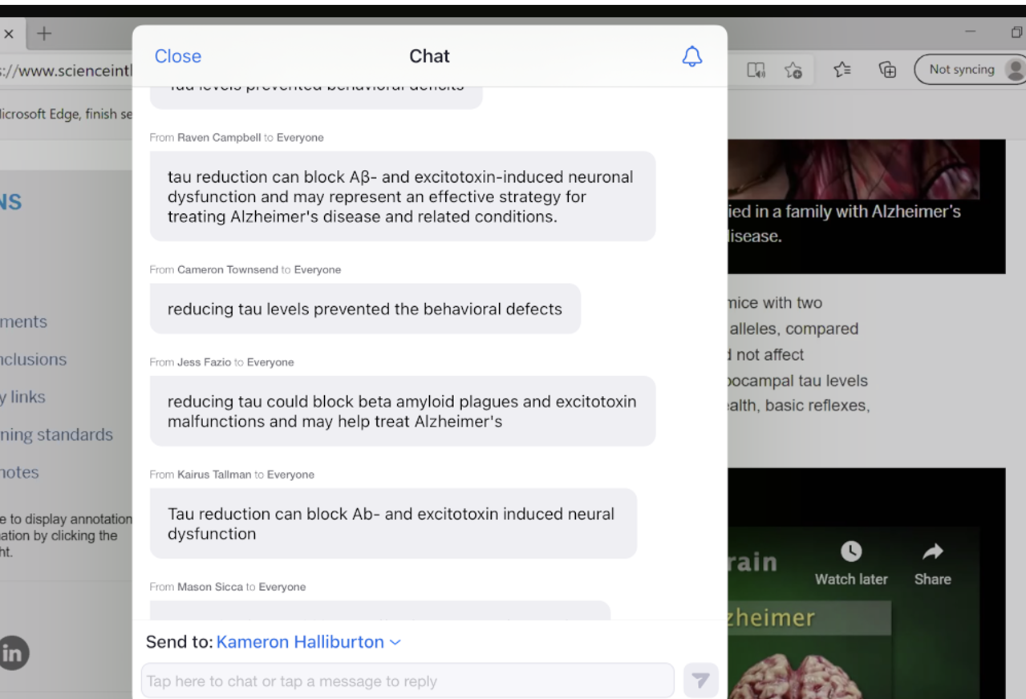
Teaching Methods

Slide 6
Science Literacy Questions
the p21 protein:
is synthesized during S phase
causes cells to arrest in G2
promotes an acceleration of late G2
is involved in the spindle checkpoint
Which of the following would provide the strongest evidence supporting the authors’ claim of “induced expression of p21 and p53 is essential to sustain the G2 checkpoint after DNA damage in human cells.”
p21 protein was synthesized in G2
p53 and p21 are involved in the spindle checkpoint
p53 mutations provided cells with a selective growth advantage
G2 arrest was not sustained in the absence of functional p53

Slide 7
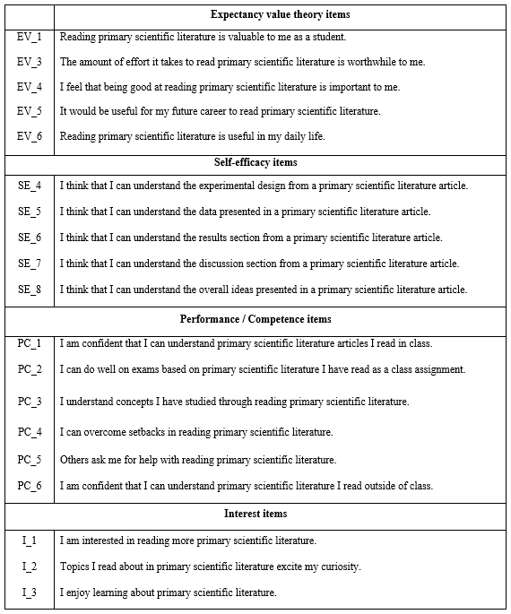
Motivation in Reading Primary Scientific Literature Assessment
A 19 item novel questionnaire based on student purpose for reading PSL and student efficacy for reading PSL.
Student motivation drops significantly when they are tasked to read PSL alone
Student motivation stays constant when reading PSL as part of class

Slide 8

Question 2
Can an evidence-based PSL teaching module lead to gains in learning/reading strategies of engaging with PSL for first-year undergraduate biology students?

Slide 9
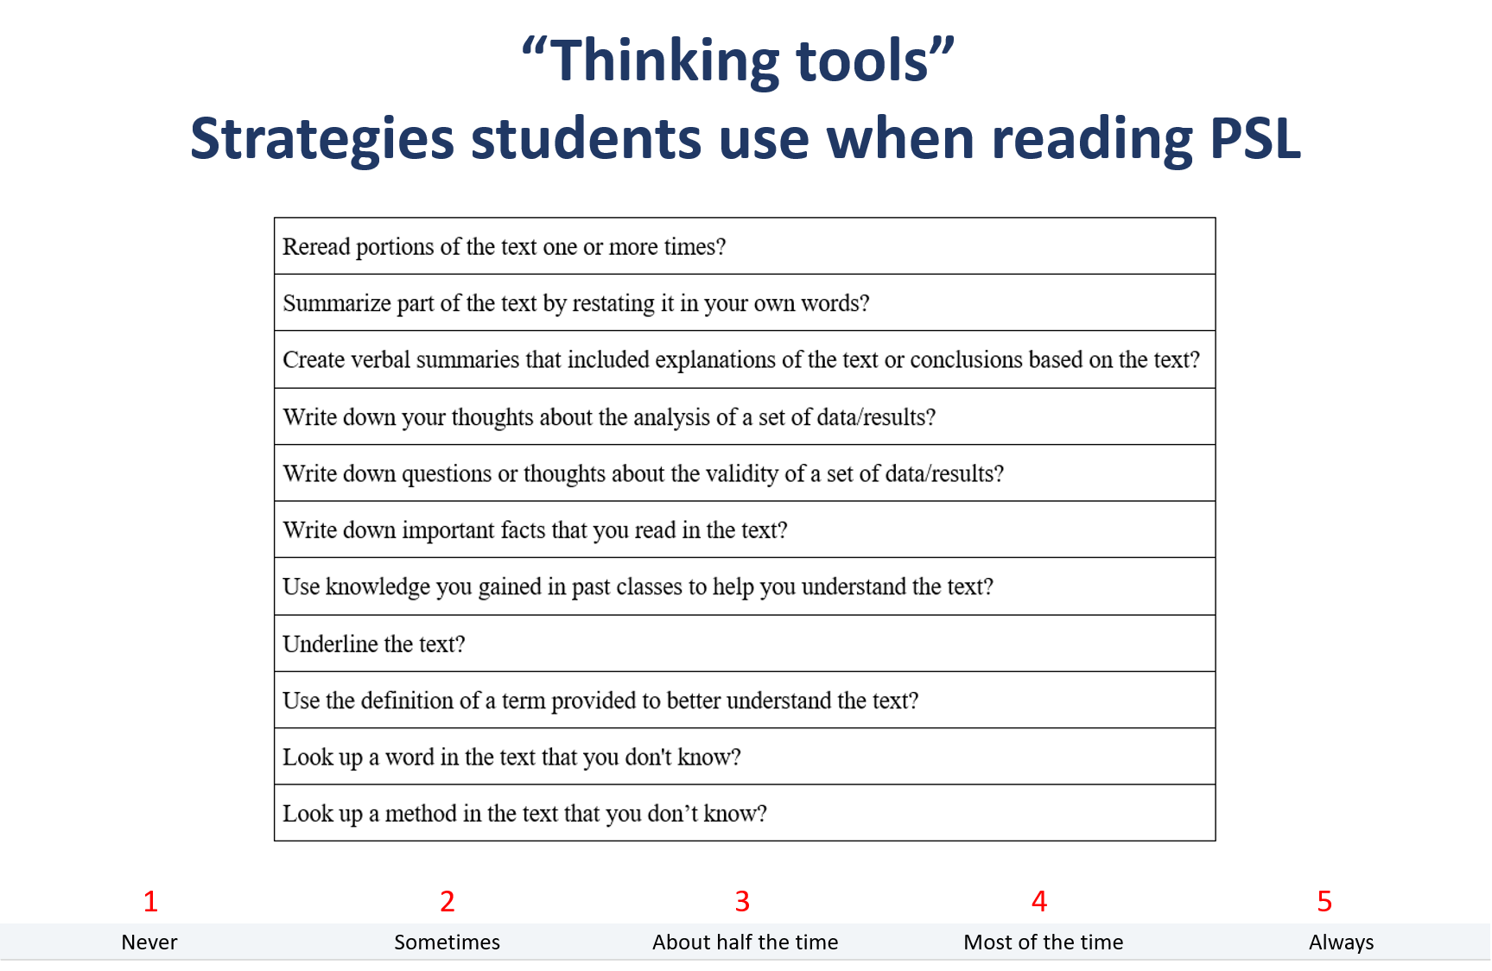
Item | When reading a piece of Primary Scientific Literature, how often do you:
1 | Reread portions of the text one or more times?
2 | Summarize part of the text by restating it in your own words?
3 | Create verbal summaries that included explanations of the text or conclusions based on the text?
4 | Write down your thoughts about the analysis of a set of data/results?
5 | Write down questions or thoughts about the validity of a set of data/results?
6 | Write down important facts that you read in the text?
7 | Use knowledge you gained in past classes to help you understand the text?
8 | Underline the text?
9 | Use the definition of a term provided to better understand the text?
10 | Look up a word in the text that you don't know?
11 | Look up a method in the text that you don't know?
summarizing
taking notes
additional information

Slide 10
 | Pre-Test (m, sd) | Post-Test (m, sd) | change | n | t | p
Institution 1 (CTL) |  |  |  | 75
summarizing | 3.3(1.053) | 3.16(1.056) | decrease |  | 1.101 | .137
taking notes | 2.793(1.152) | 2.827(1.056) | increase |  | -.280 | .390
additional information | 4.084(.983) | 4.107(.840) | increase |  | -.216 | .415
Institution 2 (Auburn) |  |  |  | 41
summarizing | 2.951(0.907) | 3.07(1.052) | increase |  | -.808 | .212
taking notes | 2.74 (1.156) | 2.585 (1.03) | decrease |  | .957 | .172
additional information | 3.927 (.953) | 3.325(1.139) | decrease |  | 2.978 | .002**
Institution 3 (ETSU) |  |  |  | 206
summarizing | 3.262(.986) | 3.45 (1.038) | increase |  | -2.34 | .01**
taking notes | 3.12 (1.015) | 3.21 (1.081) | increase |  | -1.19 | .118
additional information | 4.17 (.805) | 3.937 (.942) | decrease |  | 3.38 | <.001**
Site paper

Slide 11
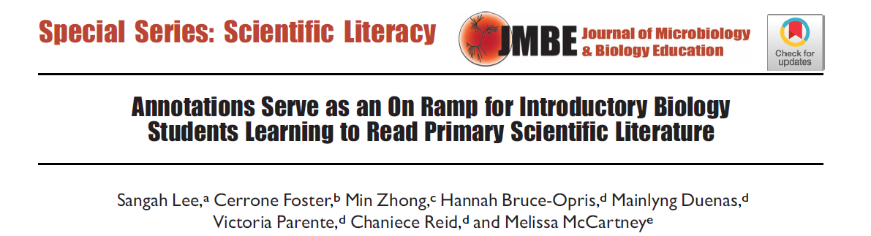
Question 3
Can annotated PSL aids in the development of reading strategies for novice students learning to read PSL?

Slide 12
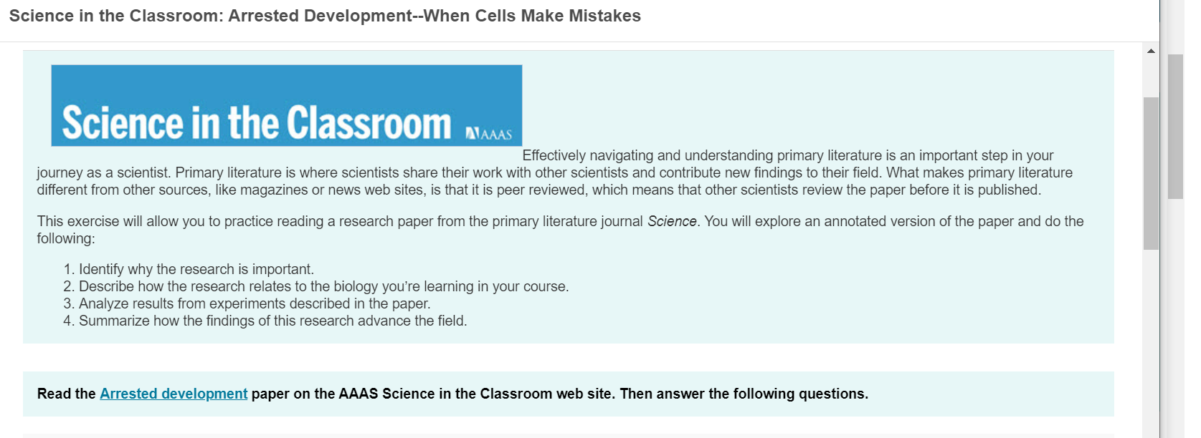
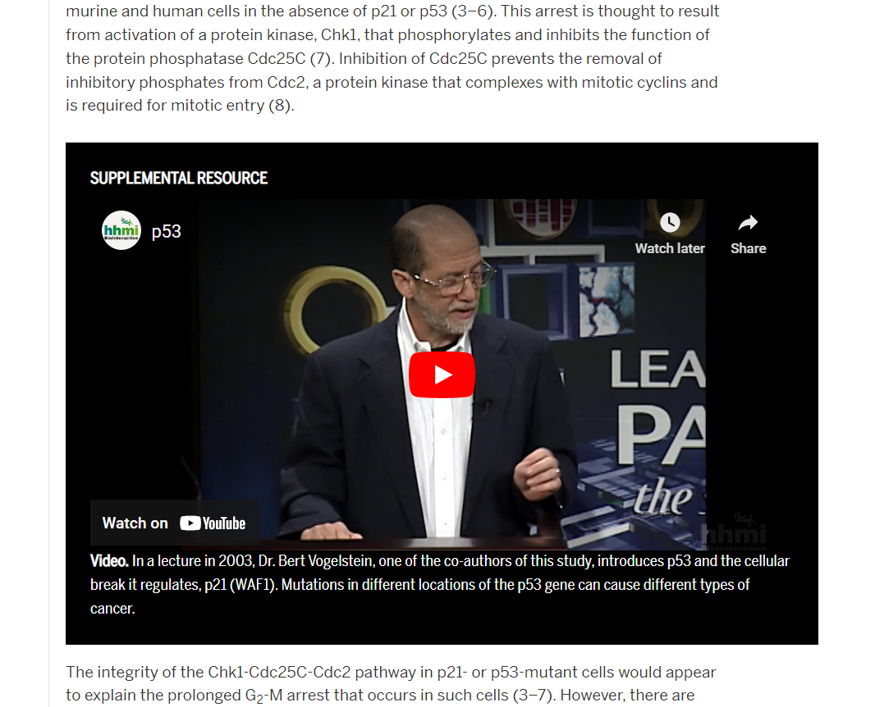

Slide 13
Item | When reading a piece of Primary Scientific Literature, how often do you:
1 | Reread portions of the text one or more times?
2 | Summarize part of the text by restating it in your own words?
3 | Create verbal summaries that included explanations of the text or conclusions based on the text?
4 | Write down your thoughts about the analysis of a set of data/results?
5 | Write down questions or thoughts about the validity of a set of data/results?
6 | Write down important facts that you read in the text?
7 | Use knowledge you gained in past classes to help you understand the text?
8 | Underline the text?
9 | Use the definition of a term provided to better understand the text?
10 | Look up a word in the text that you don't know?
11 | Look up a method in the text that you don't know?
summarizing
NO CHANGE
taking notes
additional information

Slide 14
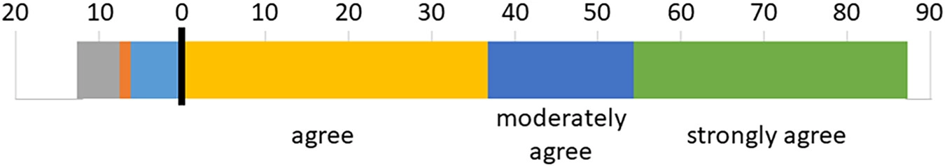
Qualitative Assessment
Students found annotations to be helpful. Students (n=157) were asked during the post course questionnaire only “Did the annotations make it easier to read PSL?” using a 6-point Likert scale question. Bars represent the percentages of students that selected a particular choice. Gray, strongly disagree; orange, moderately disagree; light blue, disagree; yellow, agree; dark blue; green, strongly agree.

Slide 15
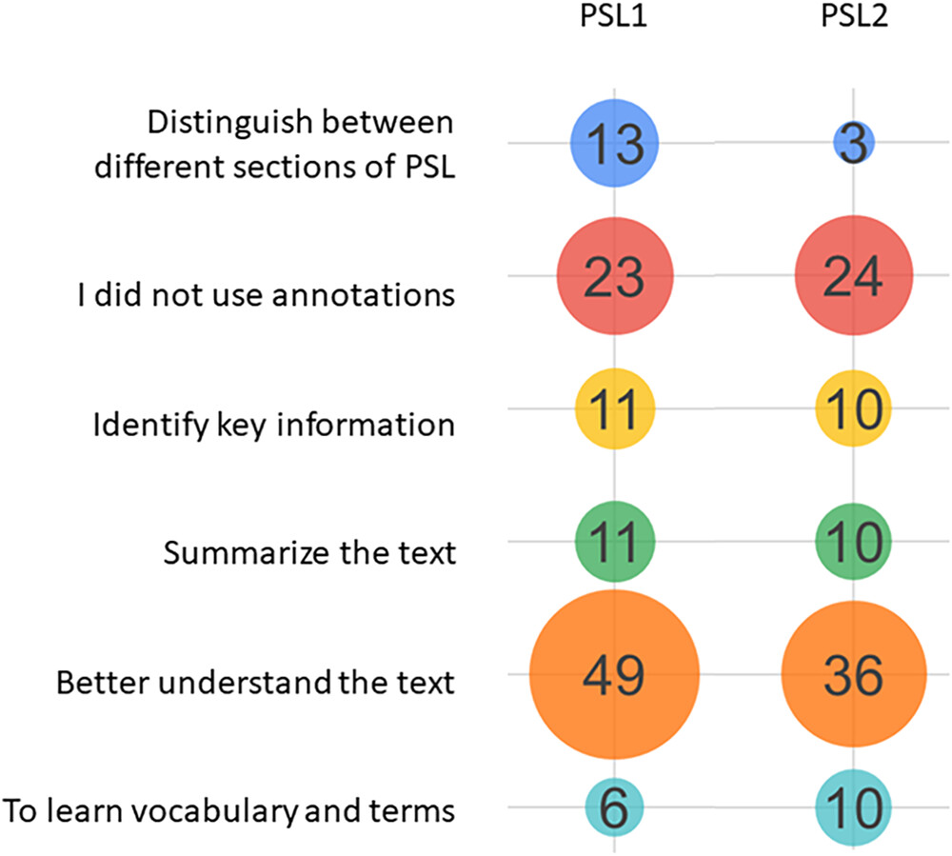
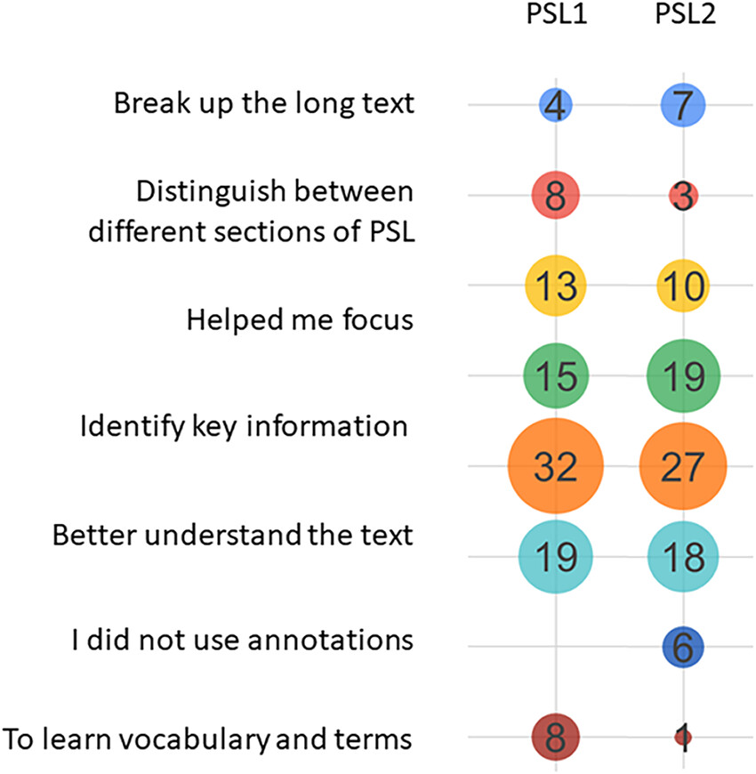
Qualitative Assessment Of Behavioral Engagement In Using Annotations To Read PSL
“How did you use annotations?”
“Did the annotations make it easier to read PSL?”

Slide 16
PSL Reading Strategies “Thinking Tools” Assessment
The PSL Reading Strategies assessment can be used as a reliable and validated diagnostic tool for development of science literacy skills
Reading a PDF alone does little to promote development of reading strategies in students learning to read PSL.
Annotated papers did not quantitatively influence in specific reading strategy development for PSL
Annotated papers help students break down PSL into manageable pieces and may be useful improve conceptual understanding and summarizing skills.

